Slide 1
Maths
Week Commencing 16th November 2020

Slide 2
With teach of the following sessions, please either print the worksheets to complete alongside the video (the video often asks you to pause it and then complete a certain question) or have the worksheet open on the screen and write the answers in the home learning books that you were given back in March. Please do not panic that you haven’t got access to a printer ☺
The lesson is structured with ‘Flash Back 4’ starter, watch the video stated and then complete the worksheets and self mark or mark with an adult.

Slide 3
Lesson 1 – Equivalent Fractions

Slide 5
Lesson 1
https://whiterosemaths.com/homelearning/year-6/week-8-number-fractions/ Click on ‘Equivalent Fractions’ video.

Slide 10
Lesson 2

Slide 12
Lesson 2 – Simplifying Fractions
https://whiterosemaths.com/homelearning/year-6/week-8-number-fractions/ Click on the ‘Simplifying Fractions’ video

Slide 16
Lesson 3

Slide 18
Lesson 3- Improper Fractions to Mixed Numbers
https://whiterosemaths.com/homelearning/year-6/week-8-number-fractions/
Click on the ‘Improper Fractions to Mixed Numbers’ video

Slide 23
Lesson 4

Slide 25
Lesson 4
https://whiterosemaths.com/homelearning/year-6/week-9-number-fractions/
Click on ‘Mixed Numbers to Improper Fractions’

Slide 27
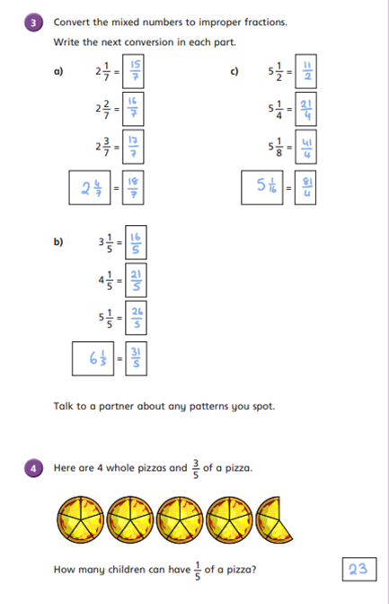

Slide 28
Lesson
For your warm-up today, please log on to your TT Rockstars account and spend 10 minutes practising your times tables and division facts

Slide 29
Lesson 5
https://whiterosemaths.com/homelearning/year-6/week-9-number-fractions/
Click on the video ‘Fractions on a Number Line’

