Slide 1
Week 6 8.2.2021
Wednesday and Thursday
This week we will continue looking at how Chinese New Year is celebrated and the importance of dragons to the Chinese celebrations.

Slide 2
The 15th day of Chinese New Year is also known as the Lantern Festival.
There are dragon and lion dancing parades in the streets, and all the streets are crowded with people.
Families walk the streets carrying lit lanterns.
Candles are lit outside homes to guide wayward spirits home.

Slide 3
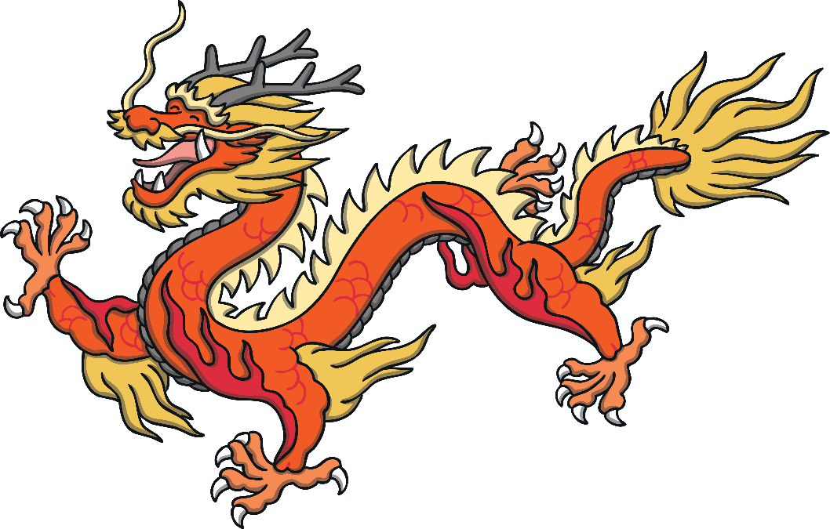
Dragon Dance

Slide 4
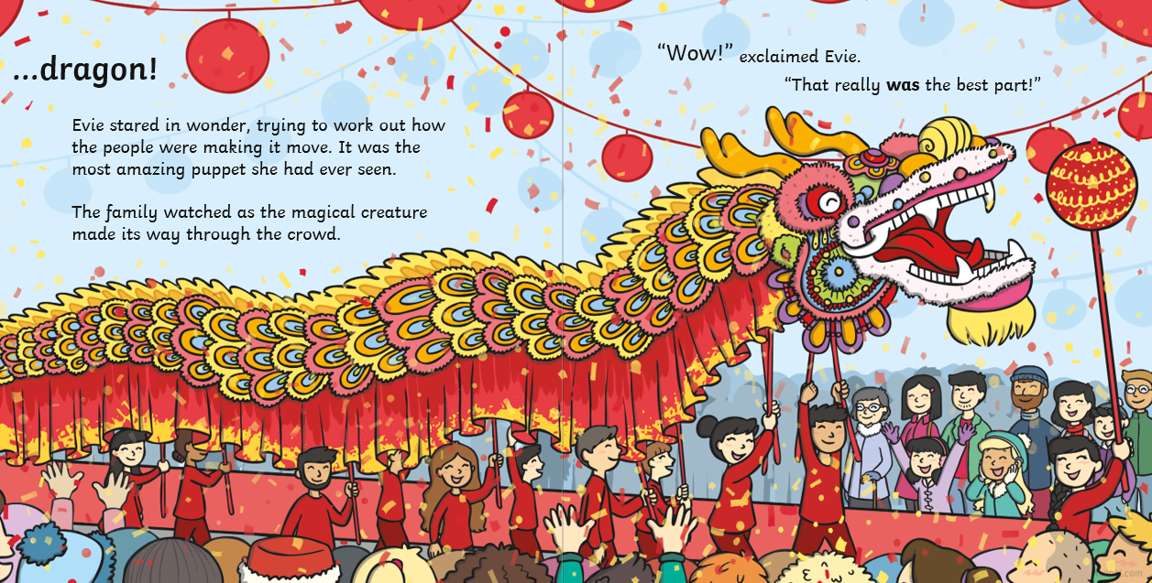
In our story Evie and Bo went to see the famous Dragon Dance, which is a big part of the Chinese New Year Celebrations.

Slide 5
Watch this video of a Dragon dance.

Slide 6
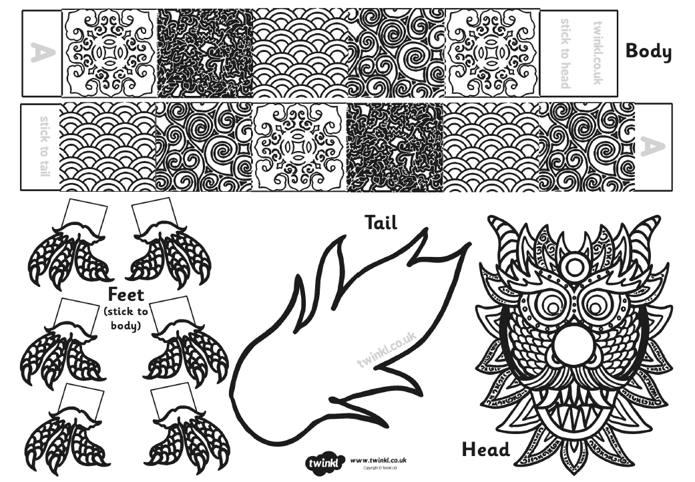
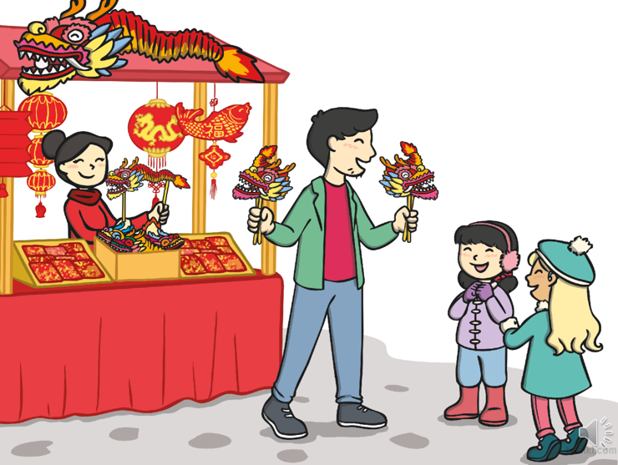
Wednesday Task: Make your own dragon.
Colour 2. Cut out 3. Fold the long body pieces so they look like a zigzag
4. Stick the dragon together by matching up the A 5. Stick the head, tail and feet on to make your dragon complete 6. If you have some skewers or garden stick add them to your dragon so that you can make it dance.

Slide 7
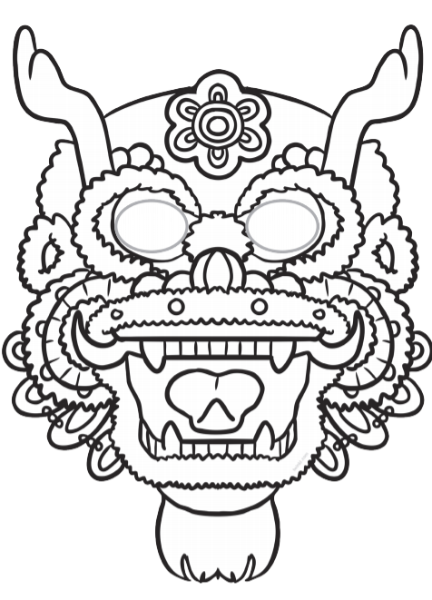
Or make a dragon mask
Here is a link to some dragon dancing music, you could make your dragon dance to it.
https://www.youtube.com/watch?v=LDEcRRQ_oOU

Slide 8
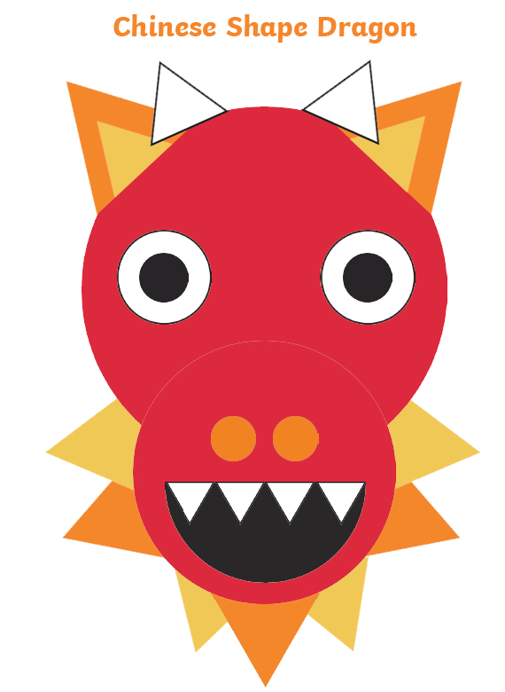
Or make a dragon picture using your 2D shapes
All worksheets are on the class page as a word document.

Slide 10
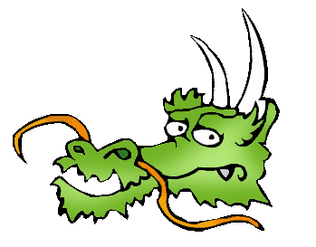
Thursday: To learn more about Chinese Dragons
In ancient China, dragons were thought to be wise, caring, and a bit mischievous.
They did not breathe fire. They had personalities. They had magical powers.
They could appear and disappear whenever they wanted.
They could turn into beasts if they were angry.

Slide 11
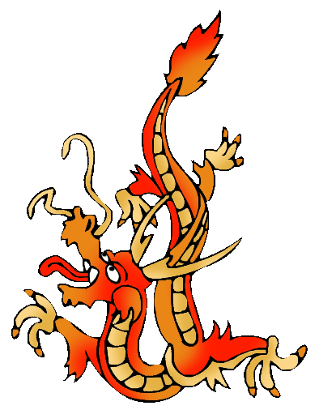
These mythical creatures had
a snake neck,
a camel head,
fish scales,
eagle claws,
tiger paws,
ox ears,
deer horns,
and whiskers.

Slide 12
Thursday Task 1: Design your own dragon.
Draw your own dragon by choosing parts of different creatures.
Label your dragon.
DO NOT COLOUR YOUR DRAGON YET!

Slide 13
Read the next few slides to find out about different dragons

Slide 14
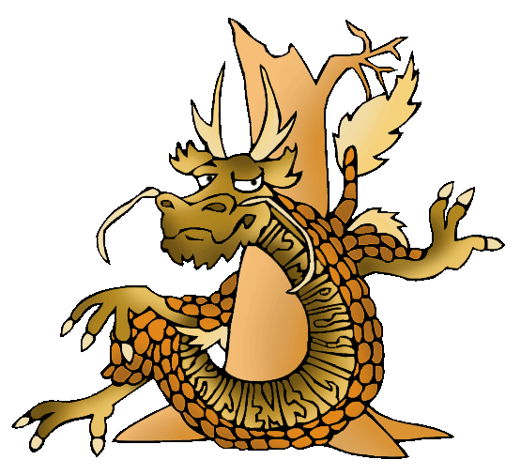
Wood Dragons
Legend says …. Wood dragons are brown.
They guard the forest. They are imaginative and curious, and come up with brilliant new ideas.
They are not as selfish as the other dragons. They share well.

Slide 15
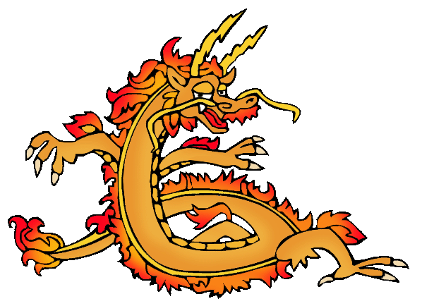
Fire Dragons
Legend says …. Fire dragons are red.
They guard the wind, fire, lightning and sky.
These dragons are the most
outgoing and short-tempered.

Slide 16
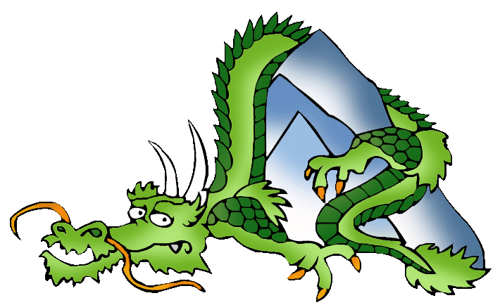
Earth Dragons
Legend says … Earth dragons are green.
They guard the earth, the crops, and the mountains.
They know the value
of cooperation.

Slide 17
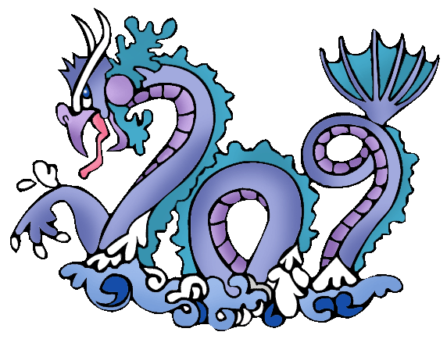
Water Dragons
Legend says …. Water dragons are blue.
They guard rivers, rain, wells, and water. They get along well with people.
They know how to accept defeat and how to rebuild.

Slide 18
Thursday task 2: What does legend say about your dragon?
What colour would your dragon be?
What would your dragon guard?
What would its personality be like?

Slide 19
