Slide 1
Spring Term
Week 3 Multiplication
Year 1
WB 18.1.2021

Slide 2
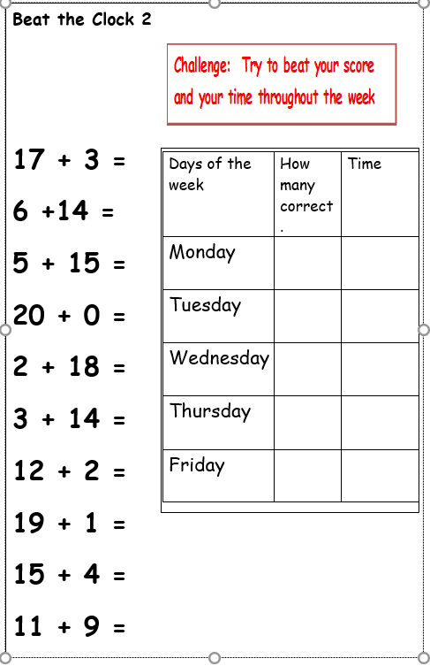
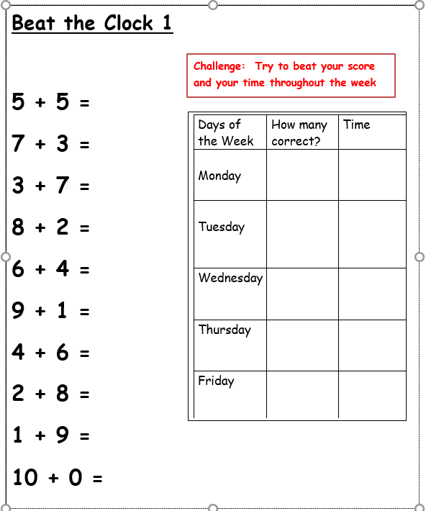
Continue practising Beat the Clock 1 if you have not got them all correct, if you have then move onto Beat the Clock 2.

Slide 3
Monday`s session is on a different powerpoint for doubling.

Slide 4
Each day I will try to include a warm-up exercise and then a main objective. I have tried to include a video with a virtual teacher to help with the teaching.
For the tasks, I will try to provide a practical one when appropriate and some worksheets, which are sometimes differentiated in to easiest or harder. Then, there will be some challenges for those who require more work. Please complete the amount of tasks that fit into your circumstances I do not expect everything to be completed unless you wish to.

Slide 5
Tuesday Warm-up: Complete the number equations below
Purple Group
If you need to use counters, pasta, lego etc.. to help you solve the problems.

Slide 6
Answers

Slide 7
Tuesday Warm-up: Complete the number equations below
Orange/ Green Group
If you need to use counters, pasta, lego etc.. to help you solve the problems.

Slide 8
Answers

Slide 9
Tuesday - Lesson objective: To be able to count in 5s
Watch the video below and follow the activities that you are asked to do.
https://youtu.be/BK9tXIiRueY?list=PLQqF8sn28L9yTV9WxpHw-9BbqRe_f49fr

Slide 10
Task 1: Practice the activity from the video, grouping 20 in different ways.
Draw your groups and write a sentence as the following:
3 groups of 2 equals 6

Slide 11
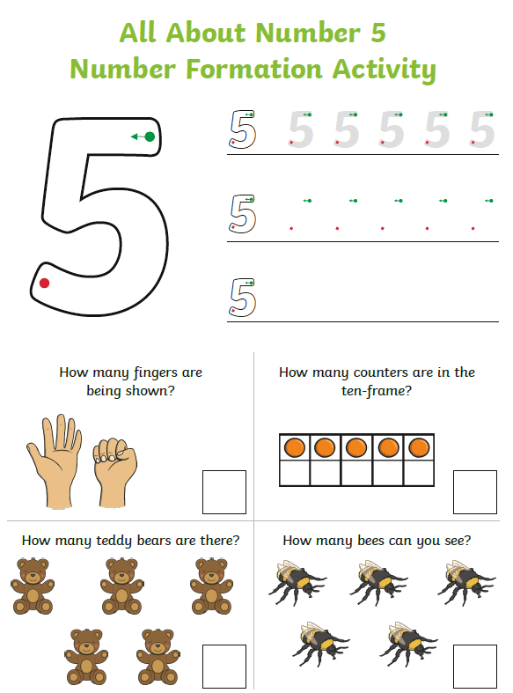
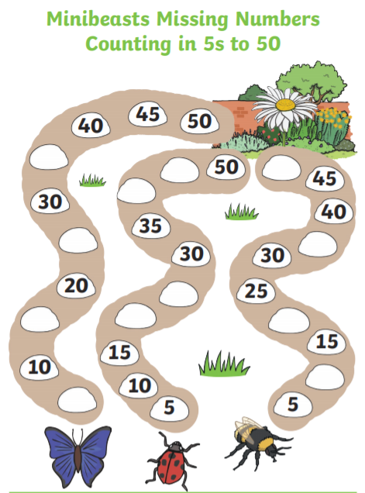
Task 2: Complete the sheets below
Easiest Worksheets

Slide 12
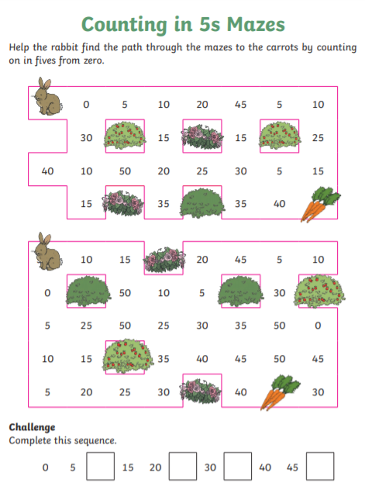
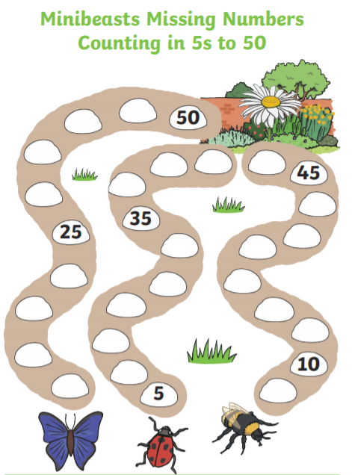
Slightly Harder Worksheets

Slide 13
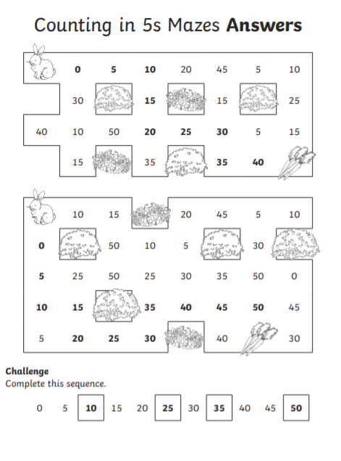

Slide 14
Something a little more challenging for those who wish to have a go.

Slide 15
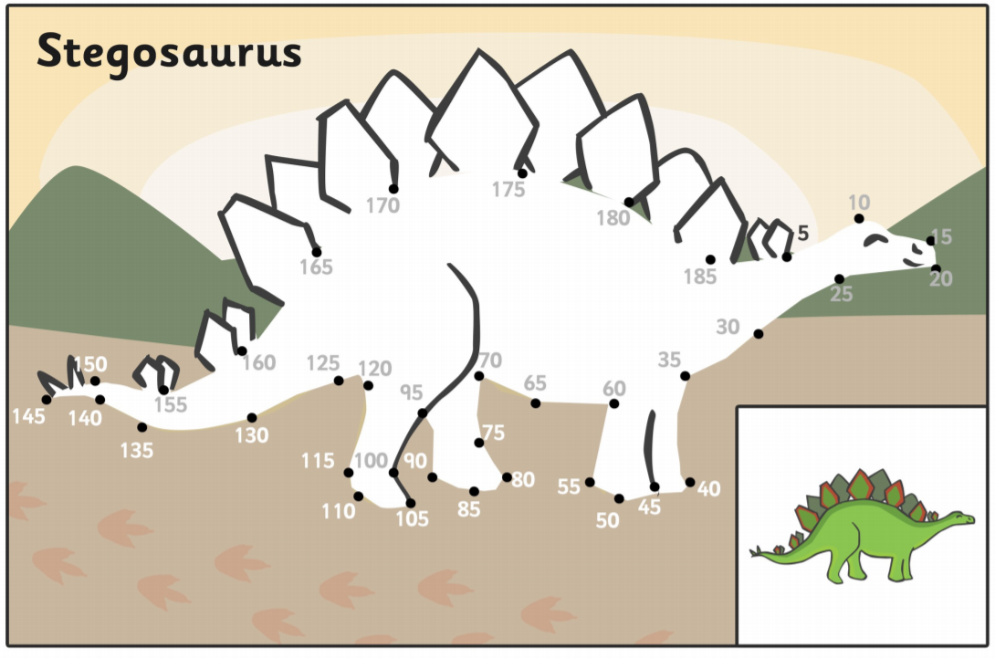
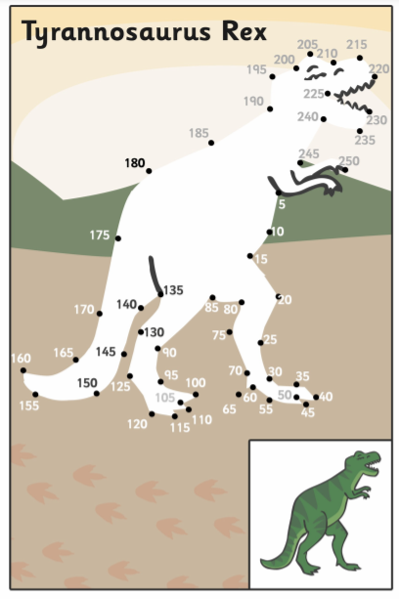

Slide 16
Deep Diving Problems
Hardest problems
Easiest problems
Harder problems

Slide 17
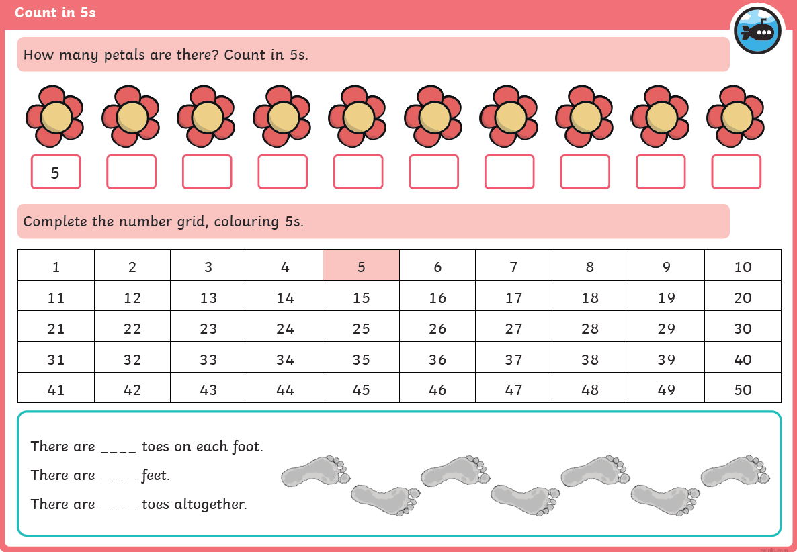
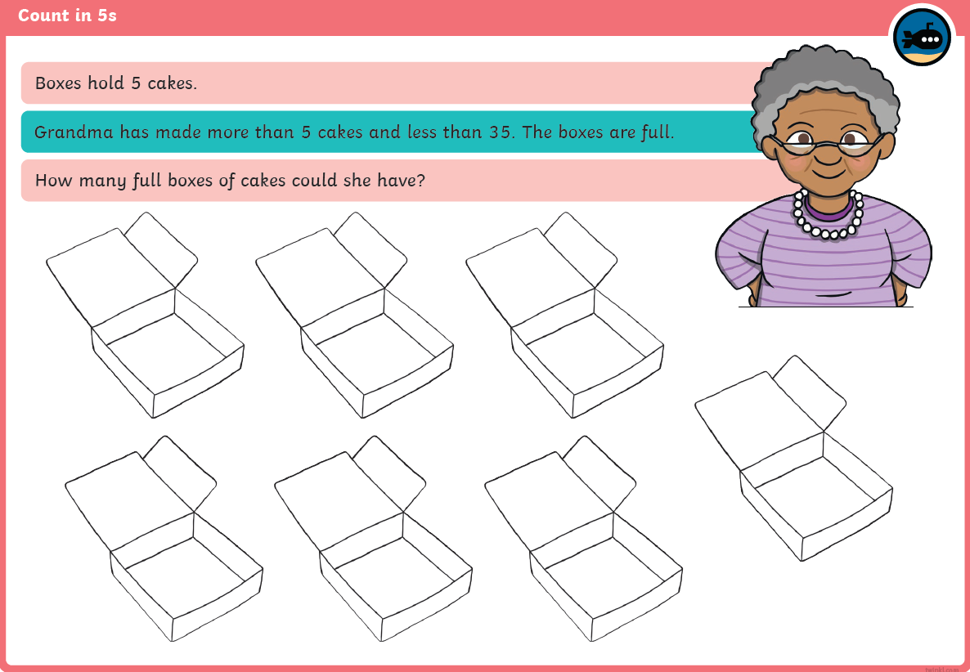
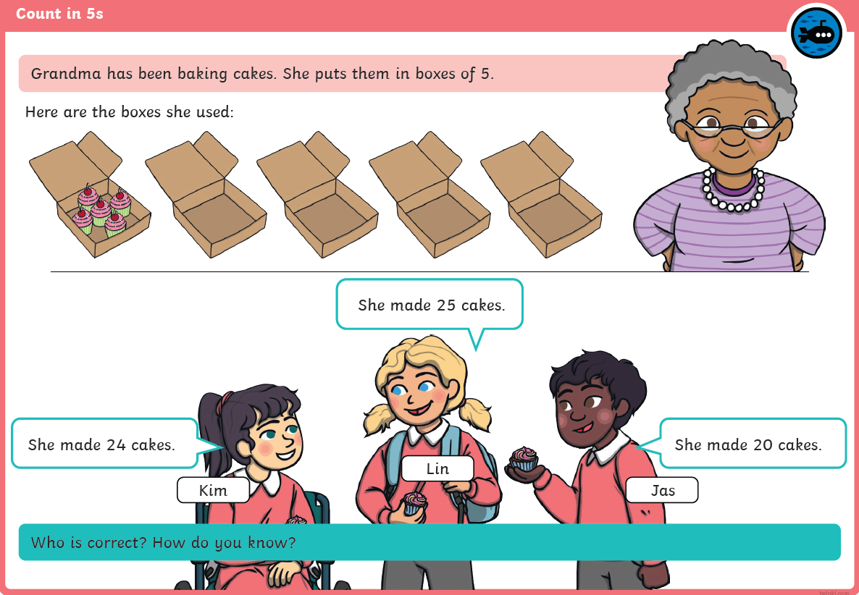

Slide 18
Wednesday Warm-up: Get moving!
Have some exercise, sing and dance along with the following songs
(When using Youtube please note there may be an advert before the song begins)
https://www.youtube.com/watch?v=EemjeA2Djjw
https://www.youtube.com/watch?v=uDSWMjtMff4
https://www.youtube.com/watch?v=amxVL9KUmq8

Slide 19
Wednesday - Lesson objective: To understand equal and unequal groups
Watch the video below and follow the activities that you are asked to do.
https://youtu.be/7MmjQ_-XlIg?list=PLQqF8sn28L9y5AGykvQTeUZw_Snz68jm7

Slide 20
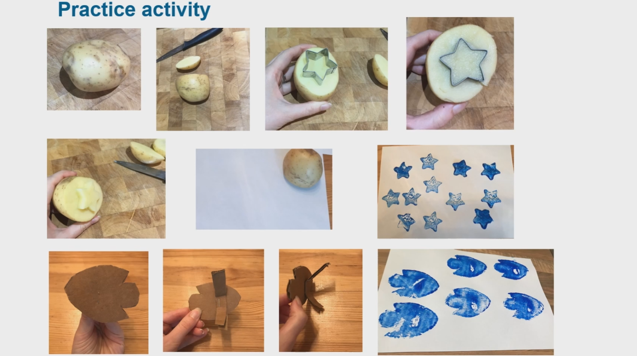
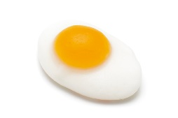
Task 1: Practise task choose how you practice your grouping
Draw pictures or take photos of equal and unequal groups using your toys, pasta, sweets etc..
Equal
Unequal

Slide 21
Something a little more challenging for those who wish to have a go.

Slide 22
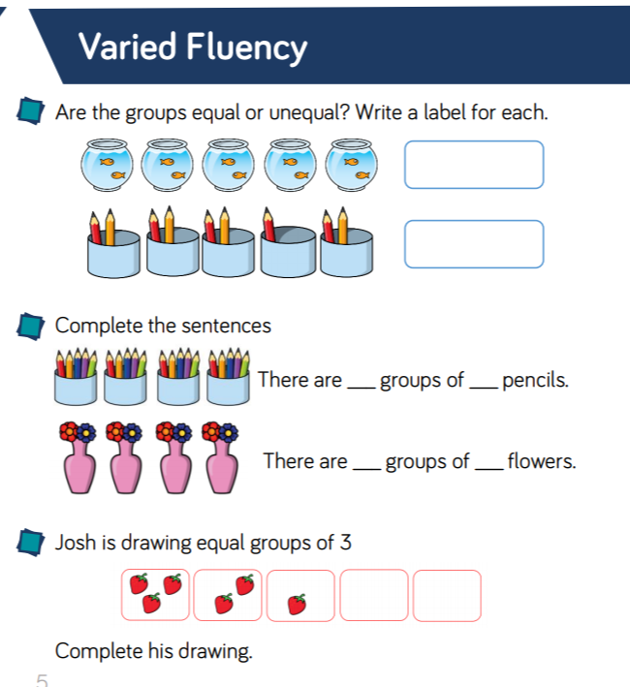
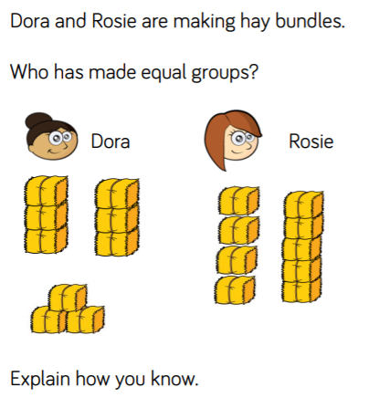
Task 2 Worksheets

Slide 23
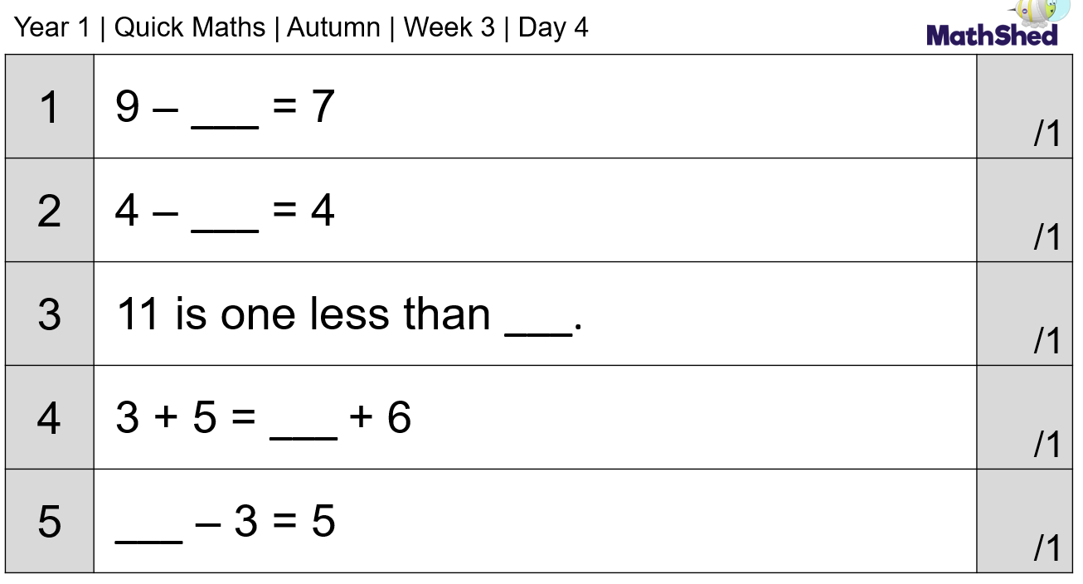
Thursday Warm-up: Complete the equations below
Purple Group
If you need to use counters, pasta, lego etc.. to help you solve the problems.

Slide 24
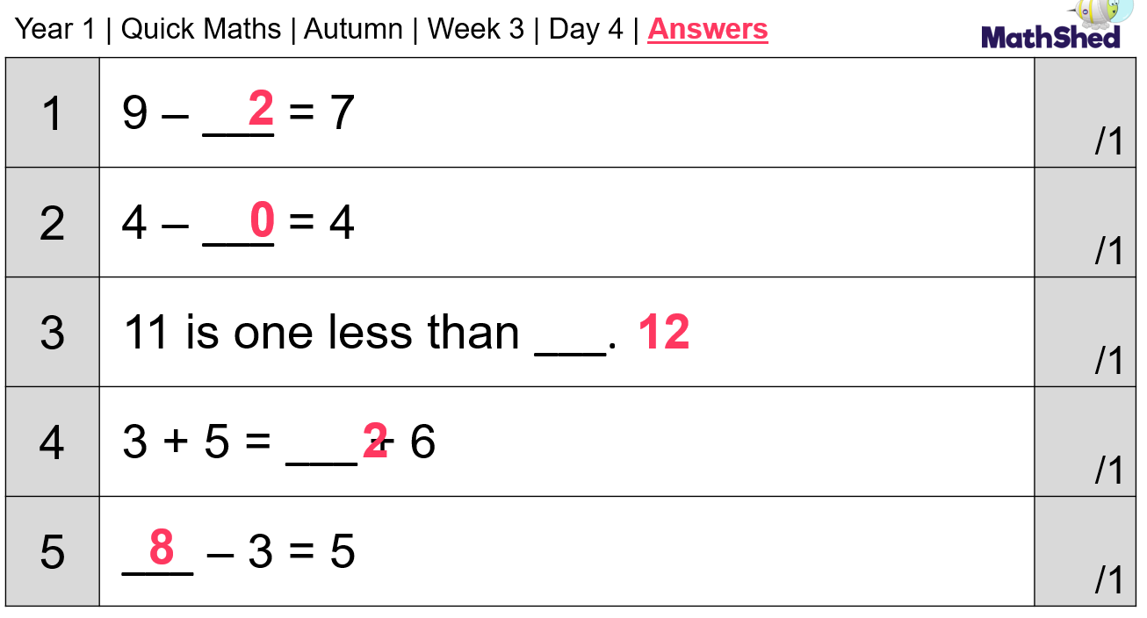
Answers

Slide 25
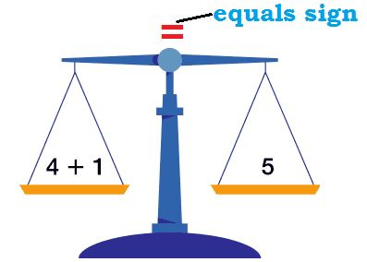
Thursday Warm-up: Complete the equations below
Orange and Green Group
If you need to use counters, pasta, lego etc.. to help you solve the problems.
Remember the = sign is like the middle of a balance scale – both sides need to have the same amount. Question 2, 4 and 5 solve the completed side first then the side with a missing number.

Slide 27
Thursday -Lesson objective: Practising Equal and unequal groups
https://youtu.be/aLOTi6MB1rg?list=PLQqF8sn28L9y5AGykvQTeUZw_Snz68jm7

Slide 28
Practise task from the video –
1.How many different ways can you put 12 objects into equal groups? Draw your groups or take a photo.
2. How many different ways can you put 20 objects into equal groups?

Slide 29
Something a little more challenging for those who wish to have a go.

Slide 30
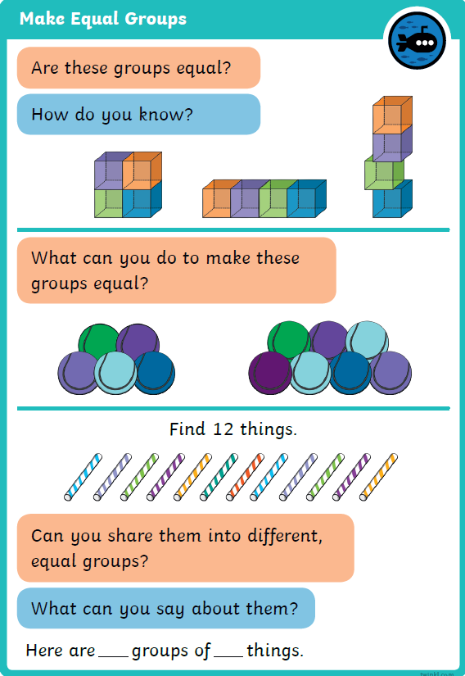

Slide 31
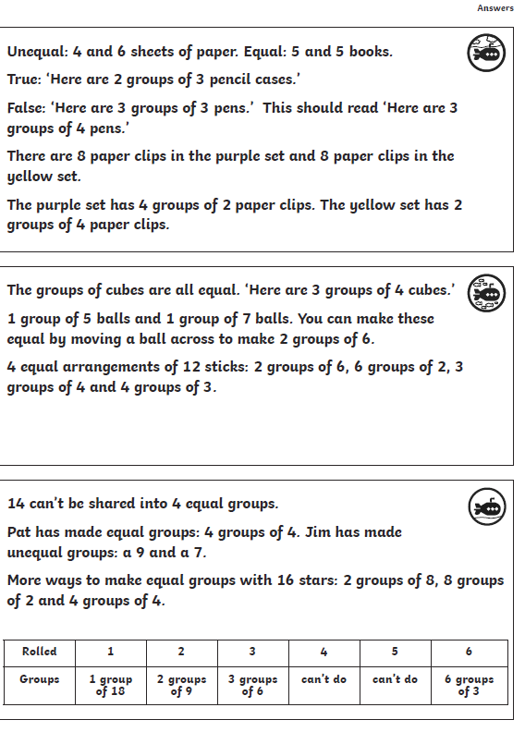

Slide 32
Something a little more challenging for those who wish to have a go.

Slide 33
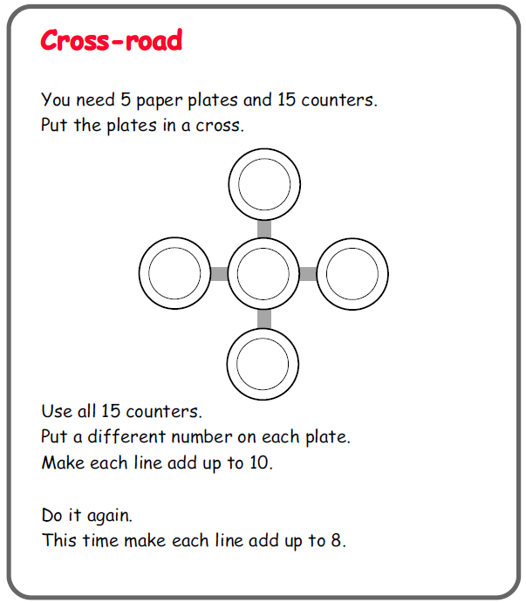
Trial and Error problems often mean you have to try many different ways until you find the solution:
You don`t have to use plates, just
draw yourself the diagram. If you don`t
have counters then use pasta or lego etc..

