Slide 1
The Flags of the Britain and Ireland

Slide 2
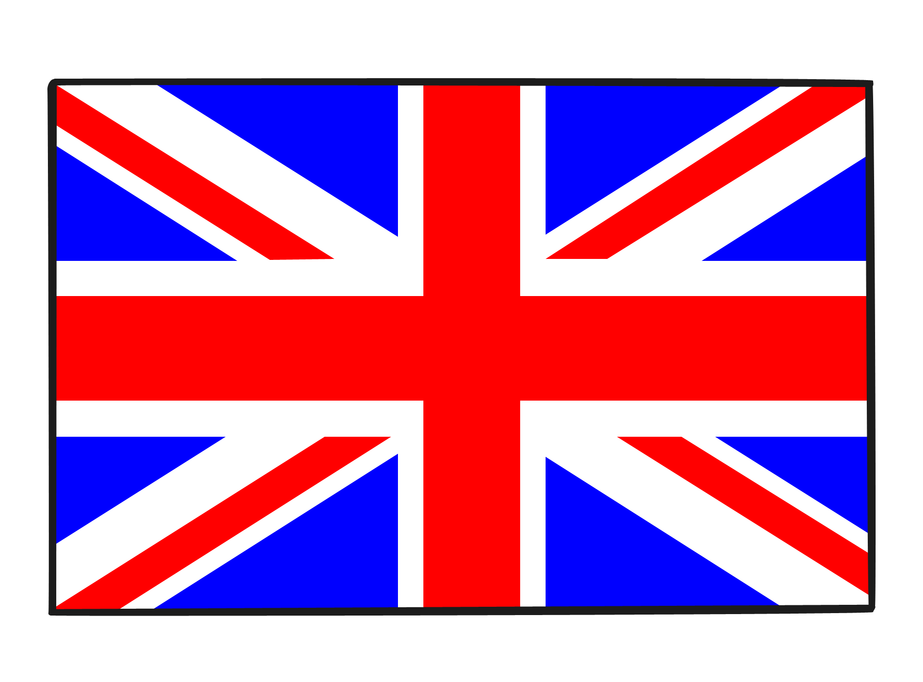
The Union Flag, also known as the Union Jack, is the national flag of the United Kingdom. It is the British flag. It is called the Union Flag because it stands for the union of the countries of the United Kingdom under one King or Queen.

Slide 3
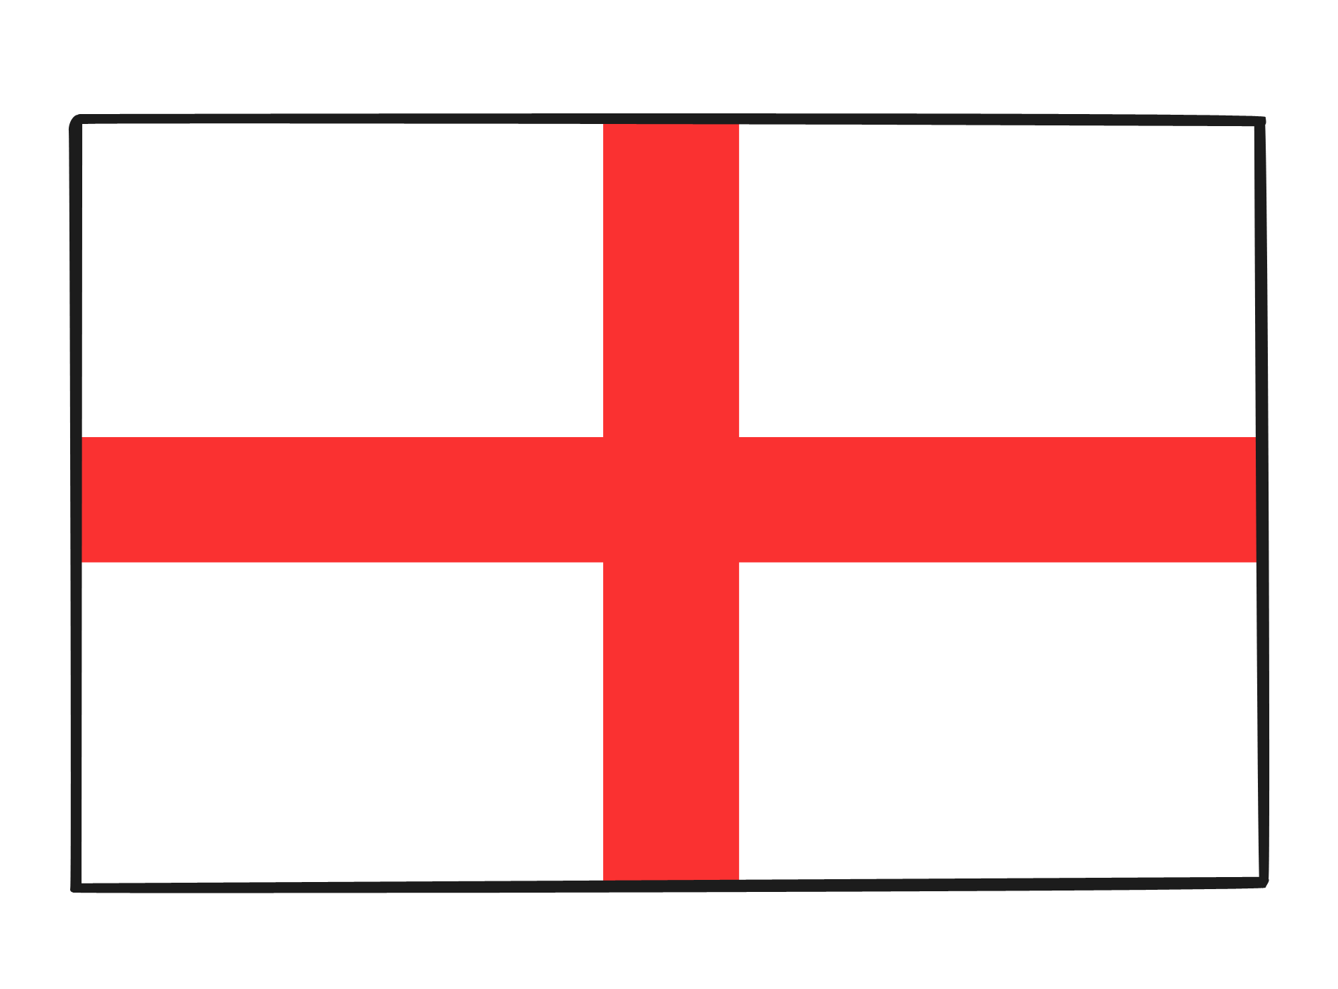
How Was the Union Flag made?
The Union Flag is made up of the flags of three of the United Kingdom's countries; the countries of England, of Scotland and of Northern Ireland.
England is represented by the flag of its patron saint St. George. The Cross of St. George is a red cross on a white background.

Slide 4
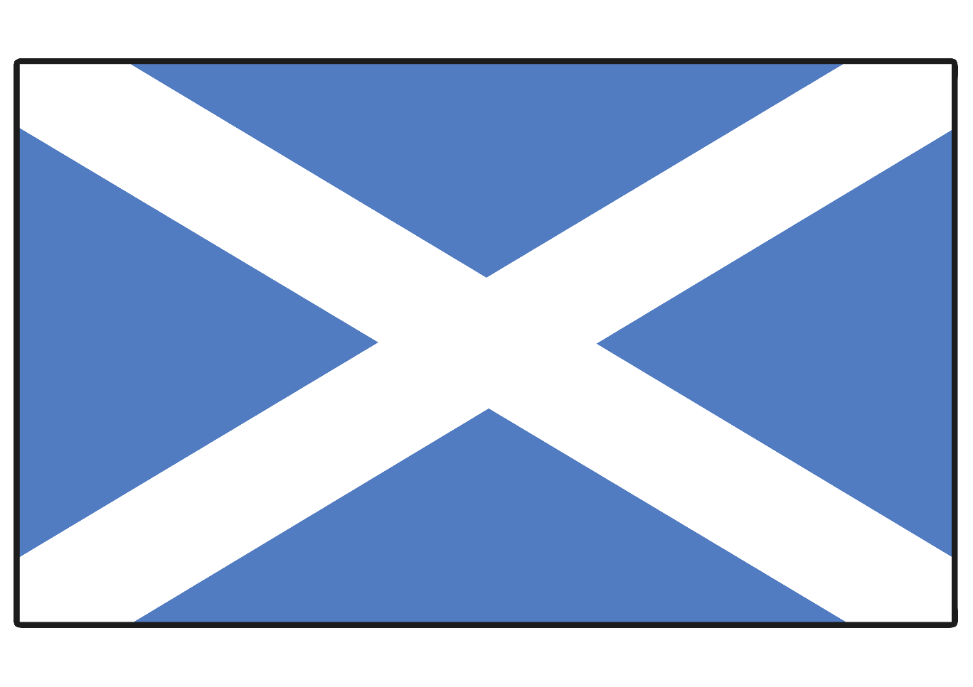
Scotland is represented by the flag of its patron saint St. Andrew. The Cross of St Andrew is a diagonal white cross or saltire on a blue background.

Slide 5
In 1801, Ireland was added to the Union flag. Ireland is represented by the flag of its patron saint St. Patrick. The Cross of St Patrick is a diagonal red cross or saltire on a white background.

Slide 6
The cross of St. Patrick was combined with the Union Flag of St. George and St. Andrew, to create the Union Flag that has been flown ever since. This Union Flag was a Royal flag and was ordered to be flown from the King’s castles and properties.

Slide 7
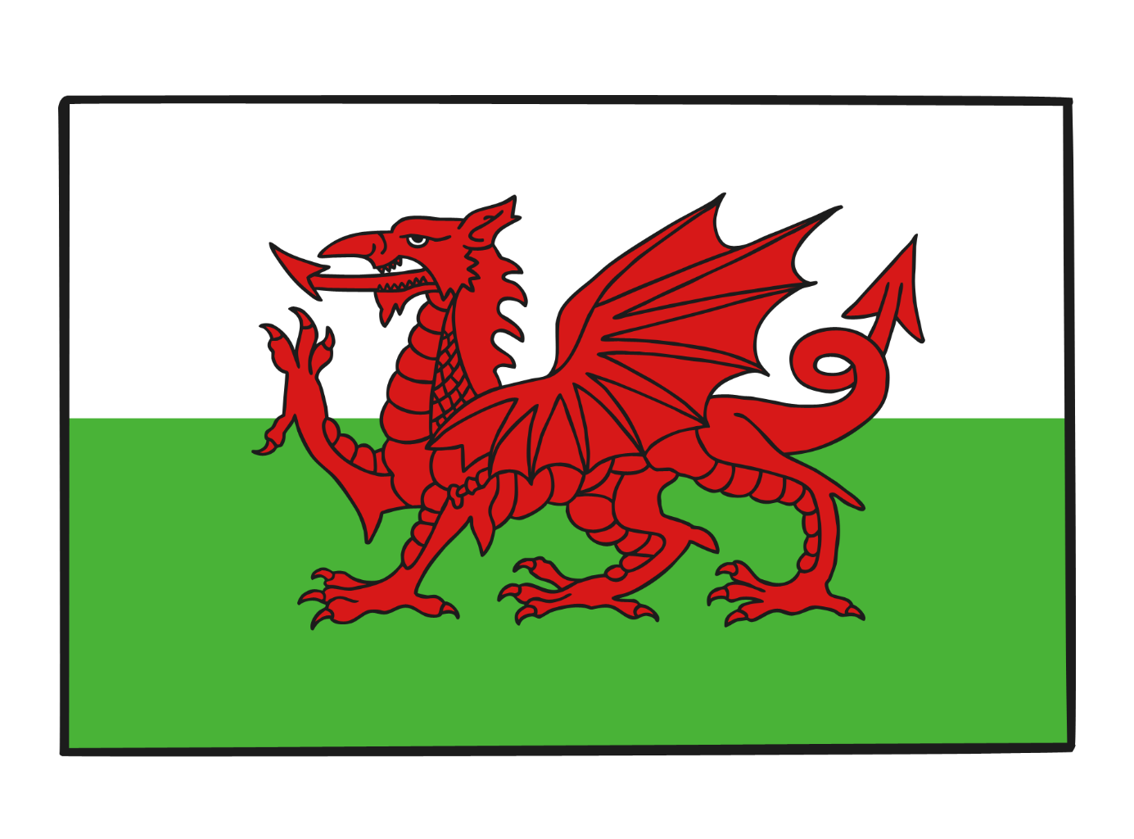
The Welsh dragon does not appear on the Union Flag. This is because when the first Union Flag was created in 1606, the Principality of Wales was by that time already united with England so the English flag represented Wales at that time.

Slide 8
Can you tell the story of the Union Flag?

