Slide 1
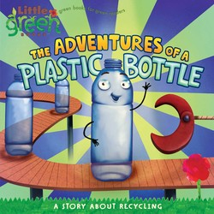
The Adventures of a Plastic Bottle

Slide 2
Session 1
Objective:
To understand information about plastic and to use this information to write a fact file
To group plastic into groups

Slide 3
What is plastic?
Plastic is a material that can be moulded into shape while soft, and then set into a rigid or slightly elastic form.

Slide 4
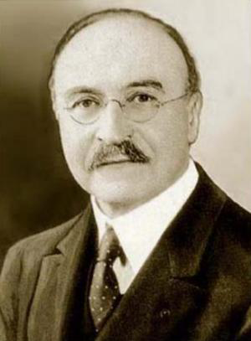
Who discovered Plastic?

Slide 5
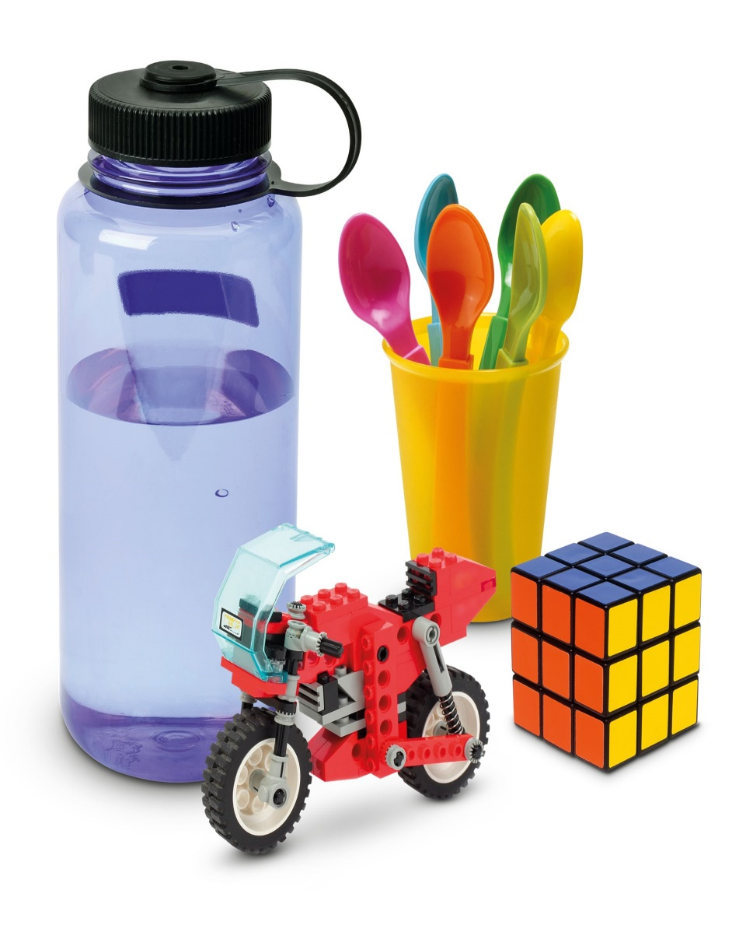
What makes plastic a good material?
It a useful material, it has different properties. It can be strong, hard, soft and flexible.
Most plastics melt when they are heated, so they are easy to mould into different shapes.

Slide 6
Good use of plastic
Can you think of any good uses for plastic?
Hospital equipment in sealed bags to keep it cleans
Limbs for people who lose an arm or leg
Car seats to protect children in cars
Bicycle helmets to protect our heads
Seatbelts to keep us safe in our cars
Airbags in cars to keep us safe
Insulation in houses to keep the heat in and the cold out
It reduces food waste as we can store left over food

Slide 7
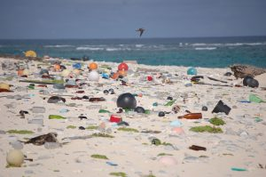
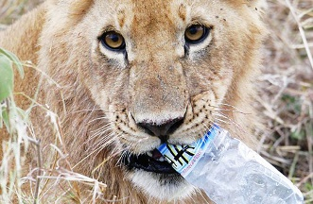
Sometimes it is thought that plastic is a bad material. Why?
Litter –
looks horrible
Animals get hurt – animals can eat plastic bags, birds get stuck in plastic bags or nets
Single use plastics - we throw them away after one use
Straws, cling film, small plastic bags
plastic forks and knives.
plastic shopping bags.
plastic coffee cup lids.
plastic water bottles.
https://www.bbc.co.uk/newsround/42651454
https://www.bbc.co.uk/newsround/42651454

Slide 8
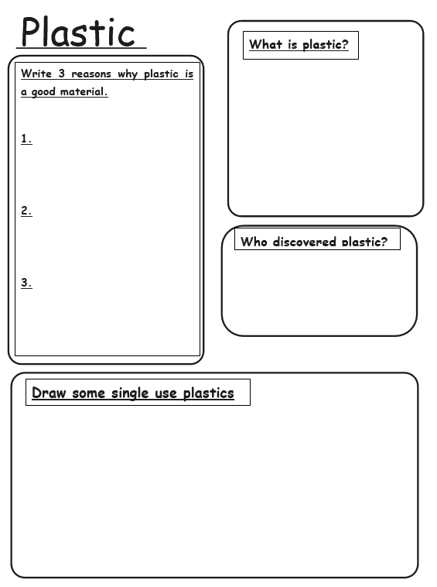
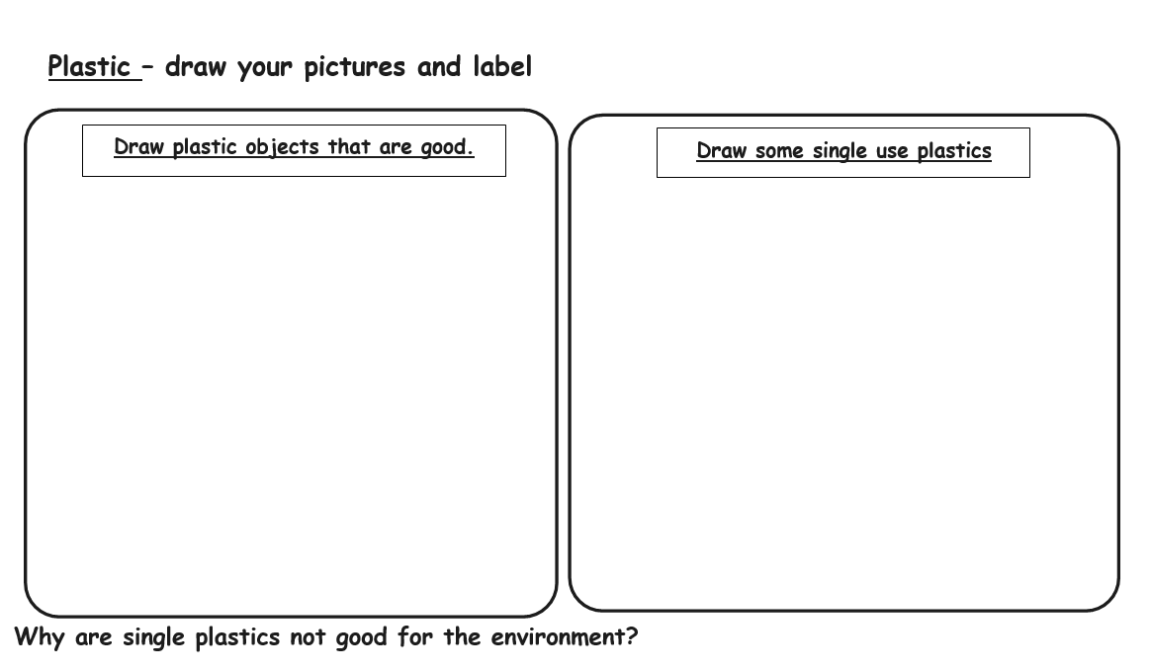
Task – grouping or writing a factfile
Year 2
Year 1
Notes:
Some Year 1s just draw the objects

Slide 9
Session 2
Objectives:
Grammar: To understand time connectives
To understand where plastic comes from
To sequence the life of a plastic bottle

Slide 10
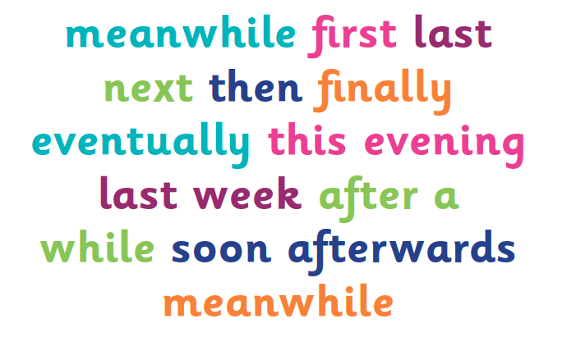
What are time connectives? When do we use them?

Slide 11
What time connectives could we use in these sentences?
____________________ we arrive in school.
__________________ we have our English lesson.
__________________ it is break time and we go out to play.
__________________ we come in to class for our Maths lesson.
__________________ it is time for our lunch. Yum!

Slide 12
Where does plastic come from?
We are going to begin the story: The Adventures of a Plastic Bottle Think about these questions as we read the story: What does plastic start as? How does it get out of the ocean? How does it travel to the refinery? What does it become at the refinery? What happens next?
Notes:
Look at the plastic bottle from the display board
Read the initial part of the story upto when the plastic bottle is made

Slide 13
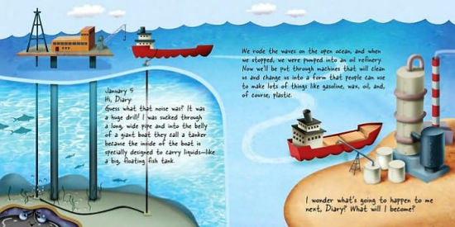
Who is writing this diary?
We rode the waves on the open ocean and when we stopped we were pumped into an oil refinery. Now we`ll be put through machines that will clean us and change us into a form that people can use to make lots of things like gasoline, wax, oil and of course plastic.
January 5
Hi Diary,
Guess what that noise was? It was a huge drill! I was sucked through a long wide pipe and into the belly of a giant boat they call a tanker because the inside of the boat is specially designed to carry liquids – like a big, floating fish tank.

Slide 14
Paired work
Work together to sequence the pictures showing the journey of plastic being made.
2. Discuss with the children how they sequenced the pictures
and use the larger pictures to model on the board.
3. Can the children tell the story of the plastic?
Notes:
Think about the vocabulary oil refinery, oil drill, ocean, underground, manufacturing plant, nibbles etc…..

Slide 15
Sequence the pictures
DW to add some of the pictures for Friday
Notes:
Children to tell DW which order the pictures should be sequenced in

Slide 16
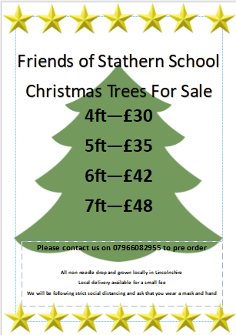
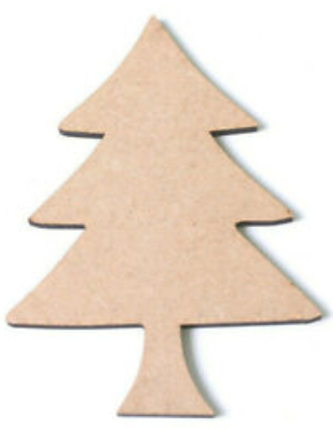
Session 3 – Write and colour a Christmas tree label to thank people for buying our Christmas trees.
What else could we put on our labels?
Thank you for buying one of our Christmas Trees.
Thank you for supporting our school.
Notes:
Children can write on the whiteboard first then onto the labels

Slide 17
Session 4 – sequence the pictures and write a sentence using a time connective
Review – Time connectives
Can you remember some of the time connectives from Session 2?
Can you remember the sequence of the pictures that show how plastic is made?
Notes:
DW to move the pictures around with the children`s help into the correct sequence

Slide 18
TASK:
Year 1: Using the same pictures from Session 2 sequence them on the story map and write a sentence underneath using a time connective.
Year 2: In English books write an explanation about how plastic is made and illustrate with the pictures from Session 2

