Slide 1
Progression in Mastery
Counting in 9’s
Can you master multiplying and dividing by 9?
©Deepening Understanding LTD 2019

Slide 2
Let’s do this!
Which of these images show us most clearly how 9 is one less than 10?
We’ll need this fact today – so keep that image in your mind! You might find it helpful to draw the images as we work out our 9 times table.
9
©Deepening Understanding LTD 2019

Slide 3
To work out 9 x 1, I can calculate 10 x 1 – 1.
To work out 9 x 2, I can calculate 10 x 2 – 2.
To work out 9 x 3, I can calculate…..
List you 10 times table facts up to 10 x 10. Now use these to calculate your 9’s.

Slide 4
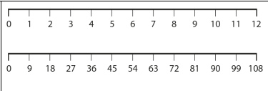
Use these numberlines to help you count in in 9’s. One group of 9 is… Two groups of 9 are…

Slide 5
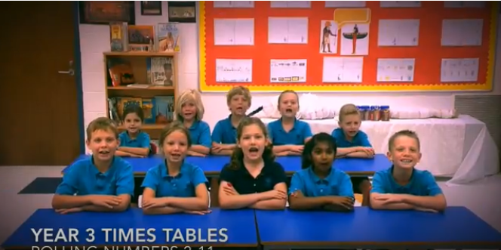
Let’s roll….
Watch the video as these children roll their numbers.
Wait until they get to their nines!
The lyrics for the ones we have done so far, ad the new ones are on the next two slides. Spend some time rehearsing these.
We’ll try sharing some number rolling next week to see how you’ve been getting on!

Slide 6
Can you use your rolling counting to fill in these missing numbers?
How can you reach the 7 x 9 using just the answer to 6 x 9?
Notes:
Reinforce we simply add or take 9 from adjacent multiples

Slide 7
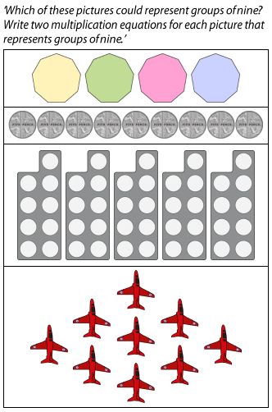
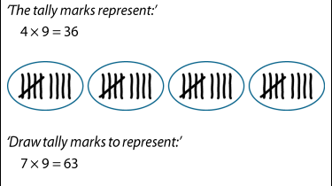
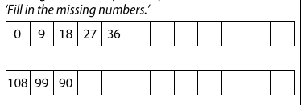
And Finally….

Slide 8
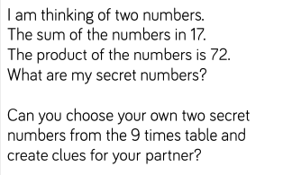
A bit more of a challenge….

