Slide 1

Spring Term
Week 4 Place Value
Purple Group
WB 25.1.2021

Slide 2

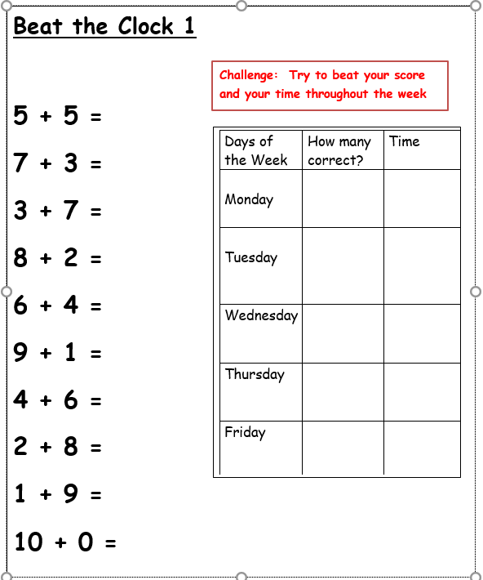
Continue practising Beat the Clock 1 if you have not got them all correct, if you have then move onto Beat the Clock 2.

Slide 3
Each day I will try to include a warm-up exercise and then a main objective.
For the tasks, I will try to provide a practical one when appropriate and some worksheets, which are sometimes differentiated in to easiest or harder. Then, there will be some challenges for those who require more work. Please complete the amount of tasks that fit into your circumstances I do not expect everything to be completed unless you wish to.

Slide 4
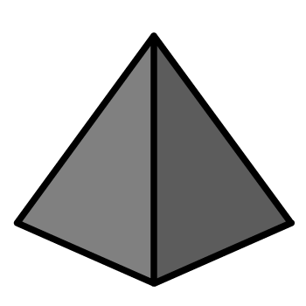
Monday Warm-up
1) What number comes next? 7, 8, 9, ?
2) What number comes next? 6, 5, 4, ?
3) How do spell the number 5?
4) How many pyramids?

Slide 5
1) What number comes next? 7, 8, 9, ?
2) What number comes next? 6, 5, 4, ?
3) How do spell the number 5?
4) How many pyramids?
10
3
five
7

Slide 6
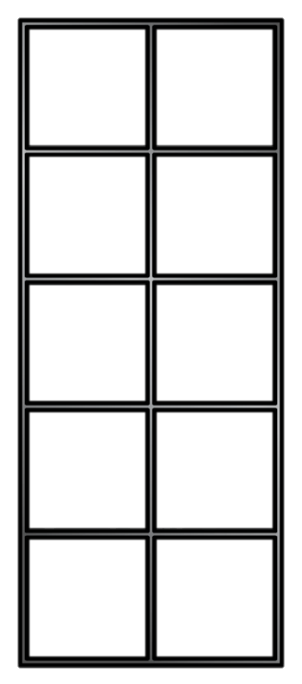
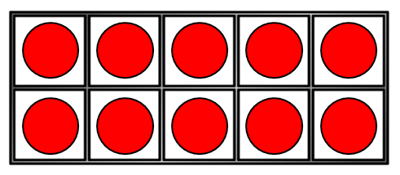
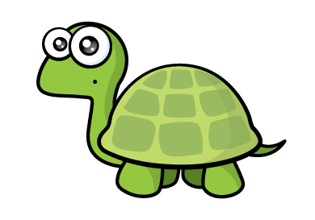
Monday objective: To count forwards and backwards to 20
Counting on from 10
11
12
13
14
15
16
17
18
19
20
10
I think I need to practise this!

Slide 7
Counting on from 10
1 | 2 | 3 | 4 | 5 | 6 | 7 | 8 | 9 | 10
1 | 2 | 3 | 4 | 5 | 6 | 7 | 8 | 9 | 10
11 | 12 | 13 | 14 | 15 | 16 | 17 | 18 | 19 | 20
11 | 12 | 13 | 14 | 15 | 16 | 17 | 18 | 19 | 20
What is the same?

Slide 8
Counting back from 20
1 | 2 | 3 | 4 | 5 | 6 | 7 | 8 | 9 | 10
1 | 2 | 3 | 4 | 5 | 6 | 7 | 8 | 9 | 10
11 | 12 | 13 | 14 | 15 | 16 | 17 | 18 | 19 | 20
11 | 12 | 13 | 14 | 15 | 16 | 17 | 18 | 19 | 20
What is different?

Slide 9

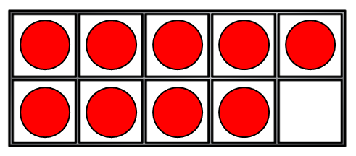
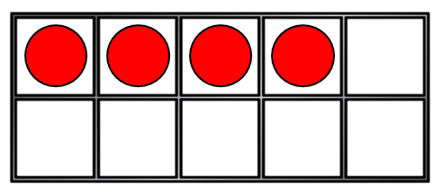
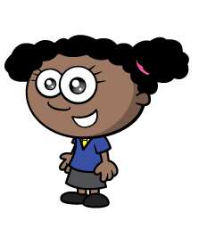
Have a think
How many?
10
10
11
12
13
14
15
11
12
13
14
16
17
18
19
I can count on from 10 to see how many!

Slide 10
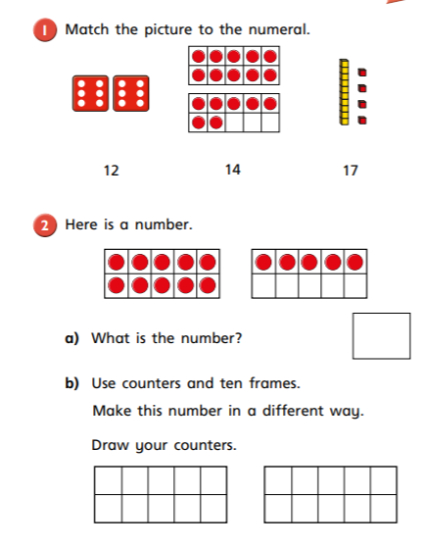
Task 1 – Complete questions 1 and 2

Slide 11
Counting on from 10
eleven,
twelve,
thirteen,
fourteen,
fifteen,
sixteen,
seventeen,
eighteen,
nineteen,
twenty

Slide 12
Have a think
Say the numbers from 11 to 20
Circle all of the numbers
that end in “teen”.
13
15
14
12
17
18
16
11
19
20

Slide 13

I see
some mistakes!
Have a think
8 | 9 | 10 | 11 | 12 | 13 | 14 | 15 | 16 | 71
8 | 9 | 10 | 11 | 12 | 13 | 14 | 15 | 16 | 17
19 | 18 | 17 | 16 | 15 | 14 | 31 | 12 | 11 | 10 | 9
19 | 18 | 17 | 16 | 15 | 14 | 13 | 12 | 11 | 10 | 9

Slide 14
Have a think
What is missing?
8 | 9 | 10 | 11 | 12 | 13 | 14 | 15 | 16 | 17
8 |  |  | 11 | 12 | 13 |  | 15 | 16 | 17
19 | 18 | 17 | 16 |  | 14 | 13 |  | 11 | 10 | 9
19 | 18 | 17 | 16 | 15 | 14 | 13 | 12 | 11 | 10 | 9

Slide 15
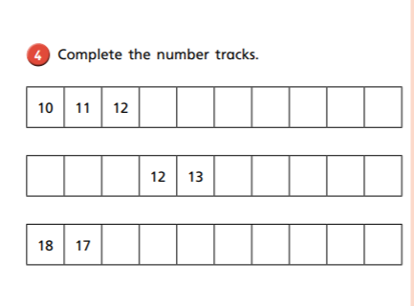
Task 2
Have a go at question 4 on the worksheet

Slide 16
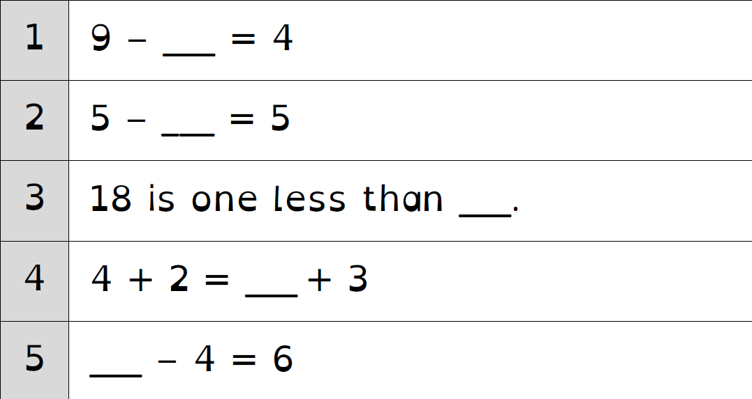
Tuesday Warm-up

Slide 17
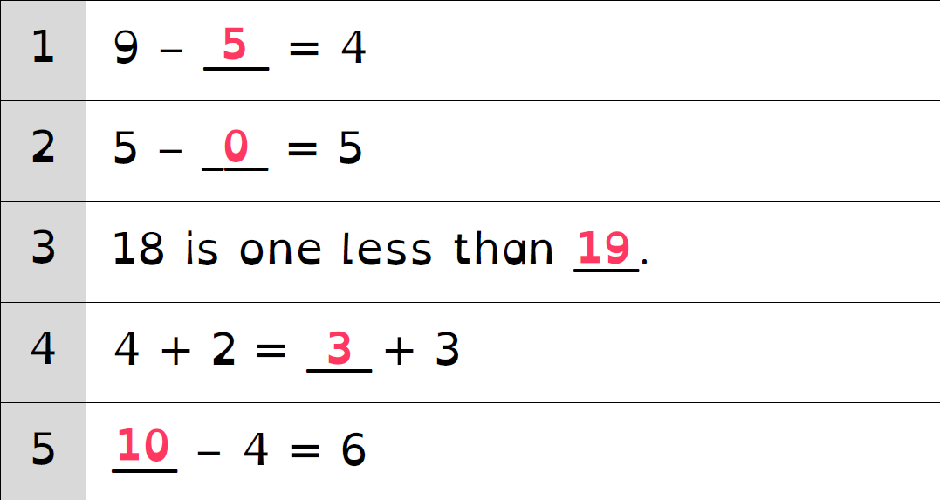

Slide 18
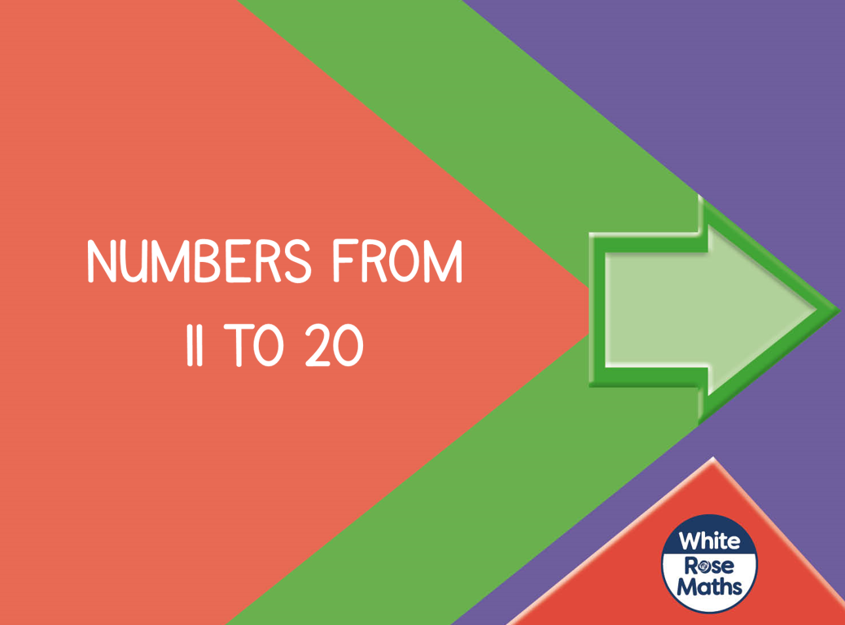
Tuesday objective: Number from 11 to 20

Slide 19
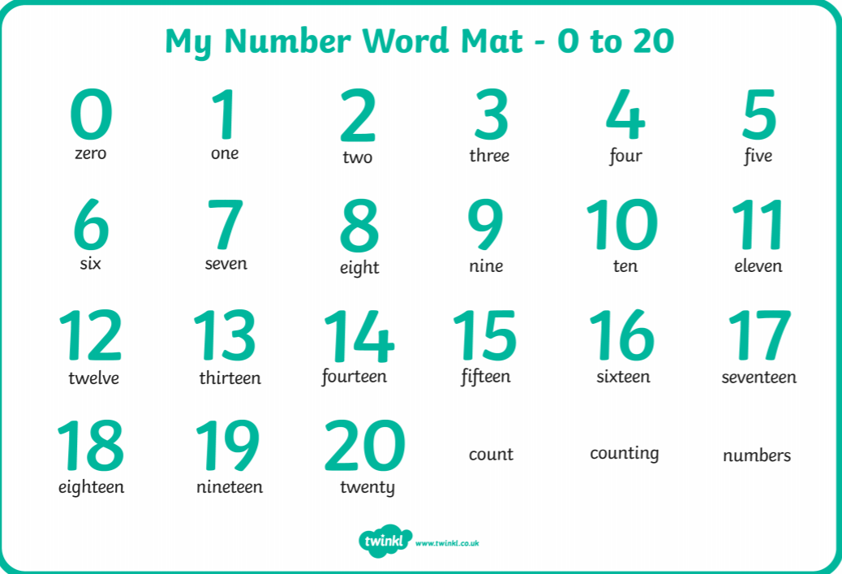

Slide 20
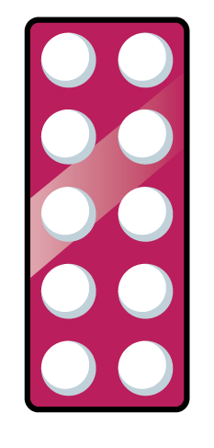






How many?
10
11
12
13
14
15
16
17
18
19
10
11, 12, 13, 14, 15
10, 11, 12
10 11, 12, 13

Slide 21
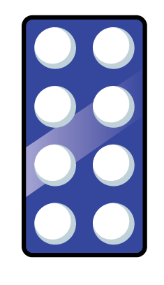
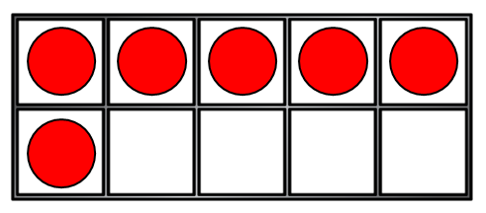

How many?
Have a think
10
11
12
13
14
15
16
sixteen
eighteen
fourteen
eleven

Slide 22
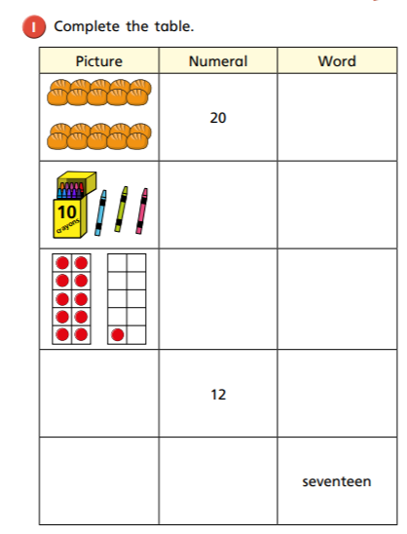
Task 1: Have a go at question 1 on the worksheet

Slide 23






Look at how many ways I can show 12!
Have a think
Which one is not correct?

Slide 24





Have a think
Pick a number between 11 and 20
How many ways can you
build your number?

Slide 25
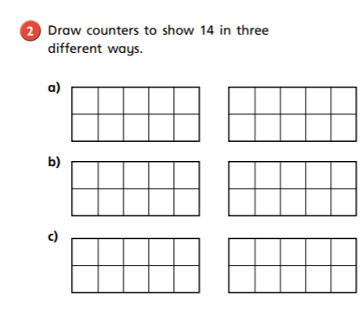
Task 2:
Have a go a question 2 on the worksheet

Slide 26
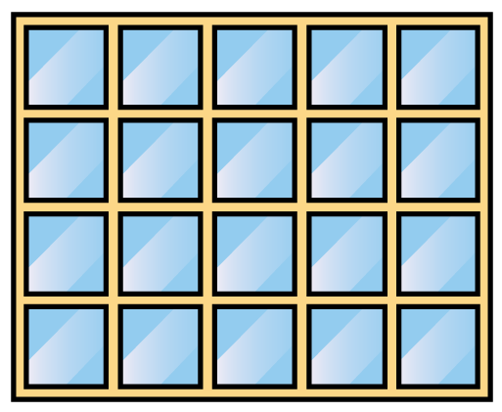
How much is 20?

Slide 27
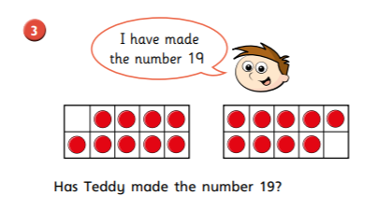
Task 3:
Have a go a question 3 on the worksheet

Slide 28
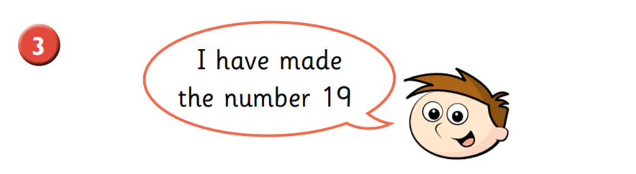
10
11, 12, 13, 14, 15, 16, 17, 18, 19
11, 12, 13, 14, 15, 16, 17, 18

Slide 29
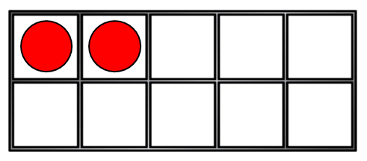
Wednesday Warm-up
1) What number is this? thirteen
2) Count from 10 to 20
3) Can you spell 14?
4) How many counters?

Slide 30
1) What number is this? thirteen
2) Count from 10 to 20
3) Can you spell 14?
4) How many counters?
13
10, 11, 12, 13, 14, 15, 16, 17, 18, 19, 20
fourteen
12

Slide 31
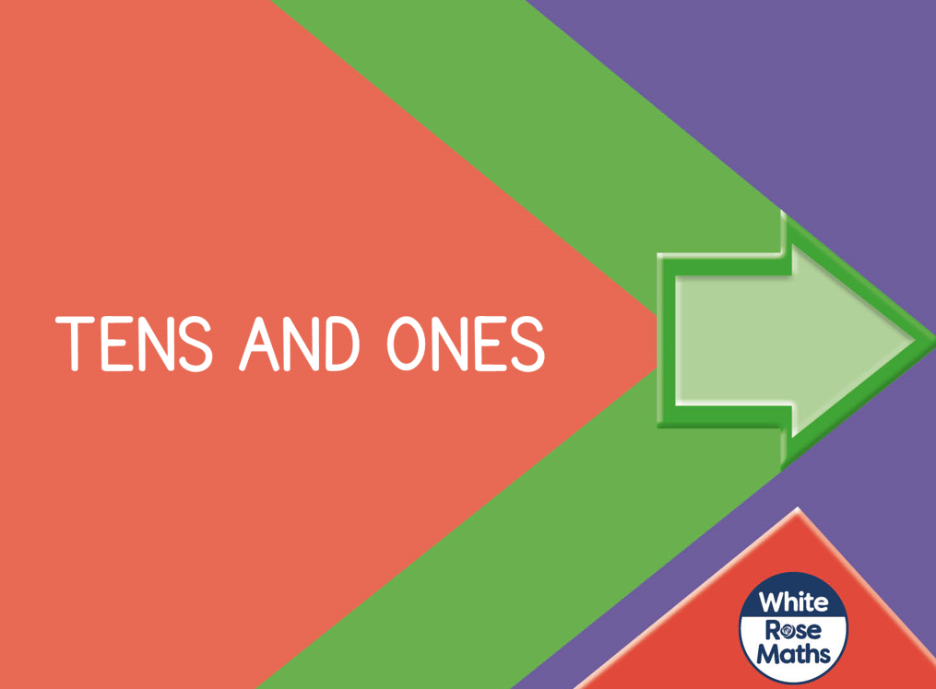
Wednesday objective: Tens and ones

Slide 32


Tens and Ones
=
Ten ONES is equal to one TEN.

Slide 33
Tens and Ones
=
One TEN is equal to ten ONES.

Slide 34


This is 10 marbles.
This is 2 marbles.
There are 12 marbles.

Slide 35
Ten and Ones
1
7
There is ten
and ones.
There are marbles.
17

Slide 36


Have a think
Tens and Ones
1
4
There is ten
and ones.
14
There are ants.

Slide 37
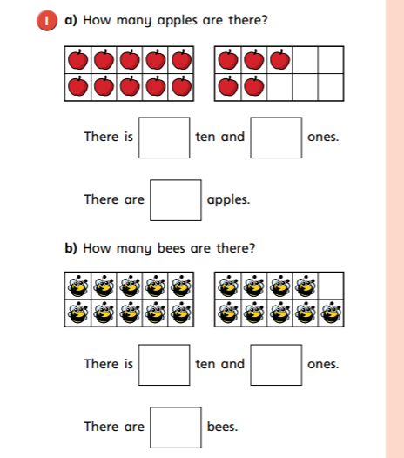
Task 1: Have a go at question 1 on the worksheet

Slide 38
Tens and Ones
1
5
There is ten
and ones.
15
There are blocks.

Slide 39
ten and ones is equal to
1
3
13
ten and ones is equal to
1
6
16

Slide 40
Have a think
ten and ones is equal to
1
7
17
ten and ones is equal to
1
4
14

Slide 41
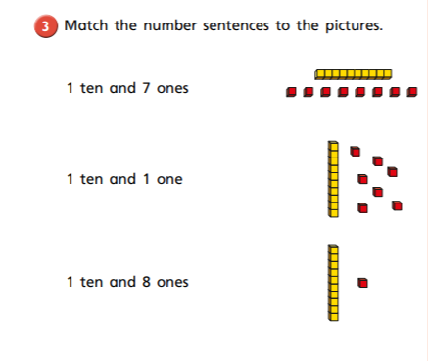
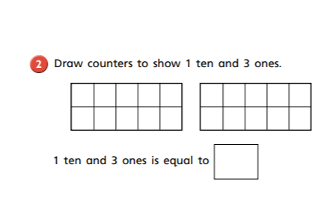
Task 2 Have a go at questions 2 and 3 on the worksheet

Slide 42
Thursday: To consolidate understanding of numbers to 20
For Thursday I have added a few extra activities that will consolidate the learning so far.

Slide 43
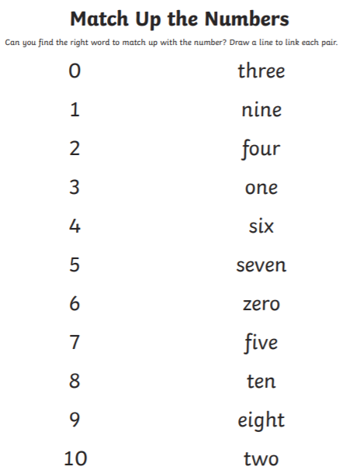
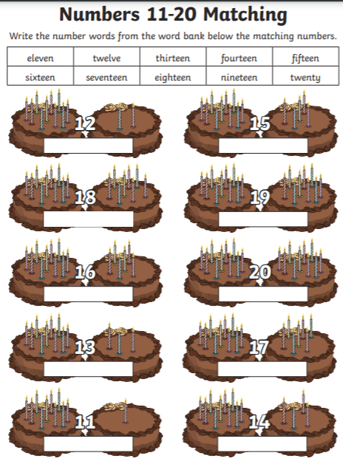

Slide 44
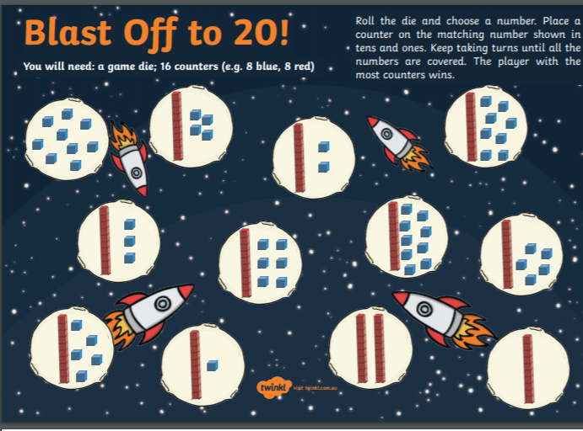
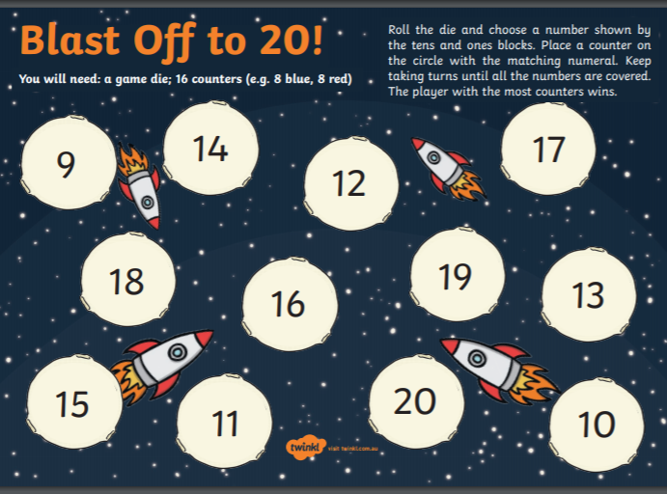

Slide 45
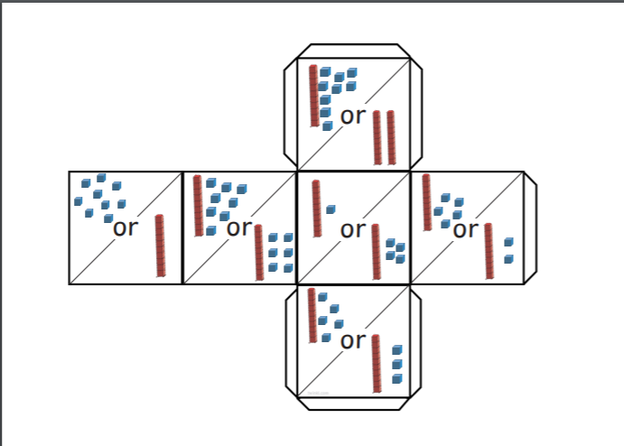
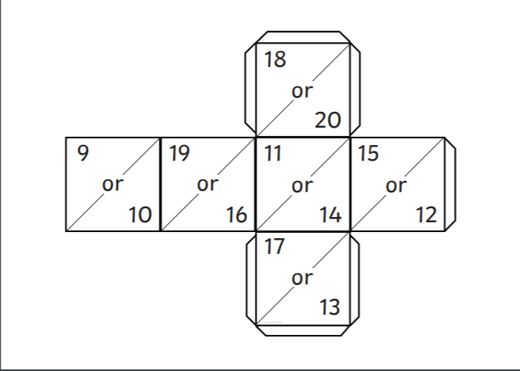

Slide 46
