Slide 1
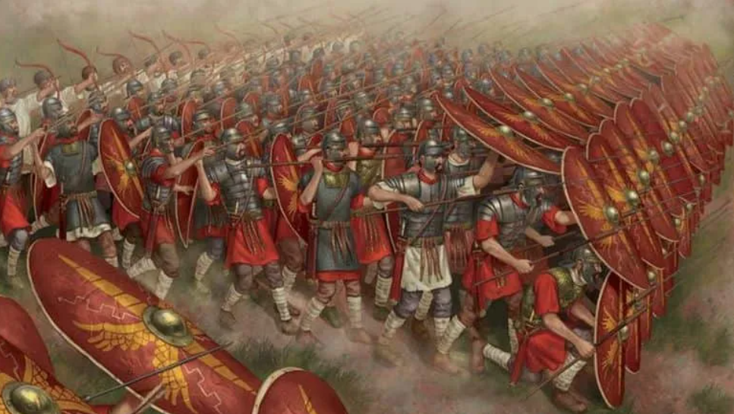
Class 3 Week 2 Writing Activities Thursday and Friday Roman Soldiers

Slide 2
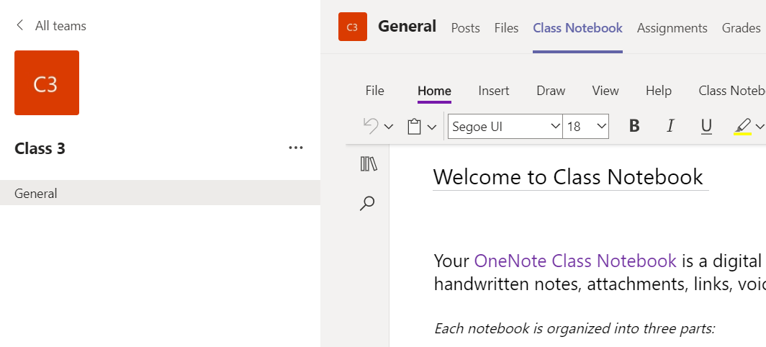
Thursday Roman Soldier Research
Collaboration Activity on TEAMS

Slide 3
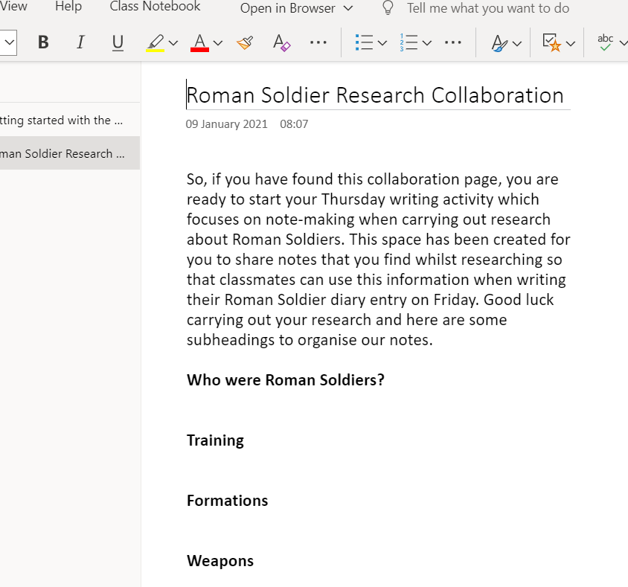

Slide 4
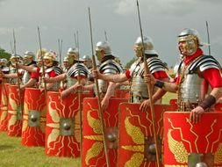
Here are some websites that you can use as a starting point.
https://www.ducksters.com/history/ancient_rome_army_legions.php
https://www.bbc.co.uk/bitesize/topics/zwmpfg8/articles/zqbnfg8
https://primaryfacts.com/1177/roman-soldier-facts/
https://www.dkfindout.com/uk/history/ancient-rome/roman-army/

Slide 5
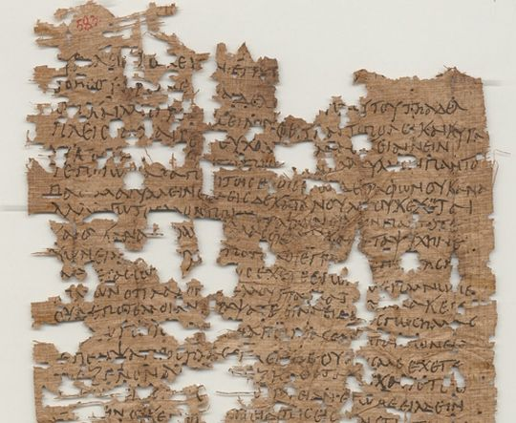
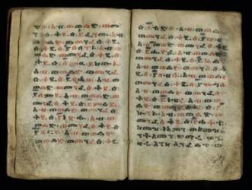
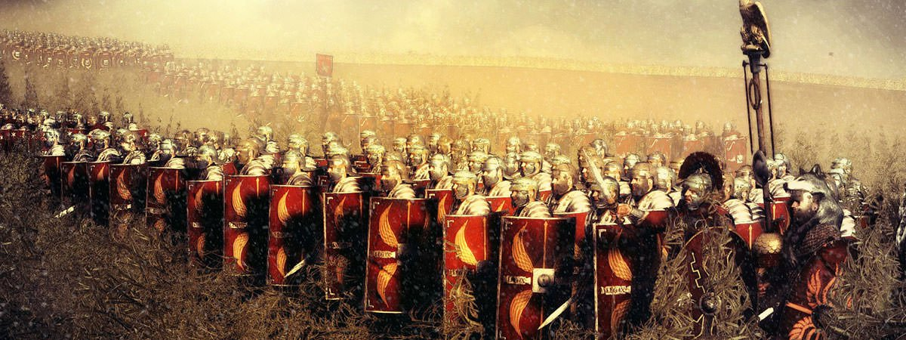
Friday Roman Soldier Diary Entry

Slide 6
For your activity today, have a go at writing a diary entry from a Roman soldier’s point of view.
You can use information from your class’ research yesterday as well as the information on the following slides which show a ‘Day in the Life of a Roman Soldier’.
Your diary should include details of some of the activities that would be part of their usual day to highlight what it must have been like.
There is also an example of a diary to help you!

Slide 7
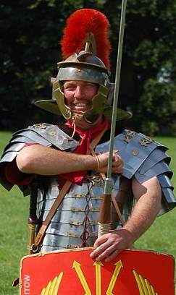
Greetings!
I am Marcus, a soldier of Legion XX Invictus. Emperor, Claudius, sent my legion and three others to Britannia, in the third year of his reign - That was in 43AD to you.
Part of our job was to build a Roman province here.
It was a lot of hard work building a province in Britannia. Most of the people who lived there, the Celtic tribes, did not like us taking control of their lands.
The first job we had after landing at Richborough, was to build a long wall and ditch to defend the harbour the navy was building.
Next, we built roads so we could travel quickly around our newly acquired land. We built forts to defend the land and towns for our people and the Celts who joined us.
The biggest defence we built to protect Roman England from the tribes who lived in Scotland was Hadrian's wall. The wall stretched 117 kilometres (73 miles) from the west coast to the east coast of England. We built it so well that even today, almost 2,000 years later, you still can see parts of it.

Slide 8
8pm
Tonight we are having a hearty meal before we set off tomorrow. It is a long march down to Kent and we need to make sure we have the energy to walk it. I will also take some figs with me to eat on the way.

Slide 9
4am - Sunrise
We wake up at sunrise and start packing our things.
As well as all our armour, we’ll need to carry:
spare clothes
food rations
a cooking pot
a short spade
two wooden stakes to help build a protective fence (palisade).

Slide 10
5am
It is 5am and we are all ready and packed to carry on our journey. We need to get a move on if we are go to reach Richborough by Wednesday.

Slide 11
10am
We’ll need to carry on marching all day before we get to rest.
If we move too slowly or complain our Centurion will beat us with a vine stick!

Slide 12
12pm
It feels so great to have a rest from carrying the equipment.
My equipment weighs about 30kg. (That’s the weight of an average 8 year old!!!! – imagine giving one a piggy-back all the way from Hadrian's Wall to Richborough!!!)

Slide 13
3pm
We’ve arrived at camp but we can’t rest yet!
We need to put up our tent. A pony carried the tent for us. The tent weighs over 40kg and is made from seventy seven large goatskins.

Slide 14
4pm
It is my turn to do the first guard duty this evening.
Even though we are all tired from the march, we still have our duties to perform. We also need to clean our armour and make more bread. We eat bread with all our meals.

Slide 15
8pm
Even though I’m on guard duty, my comrades who are off duty will get to relax by playing some board games or reading a book.

Slide 16
Dear Diary,
Today has been so tiring! Our generals woke us up extremely early so that we could begin working on a new road. I crawled out of bed and rubbed the sleep from my eyes. After eating my breakfast with the seven other men from my tent, I was grateful that it wasn’t my turn to wash up!
All morning, I worked tirelessly to build the road. Each stone had to be cut to exactly the correct size and shape and when I lifted them, the sheer weight of them made my legs tremble and my back ache tremendously.
After a few hours working on the road, the Generals commanded us to stop and ordered us to begin our training. We marched for 20 miles whilst carrying all of our spare clothes, swords, shields, cooking equipment and even our tent! My arms are aching from practising attacking, refining our different formations and learning more about our sword fighting skills. It sounds fun and exciting but believe me…my arms were really aching by the end! I was so relieved to arrive back at camp for we were exhausted and ready to eat. The food is good but we have to pay for it.
Now it is late. The camp fires will soon be put out so myself and the seven men in my tent retire to bed. It is crowded and hot although this does keep us warm!
Tonight, I am missing my family. I thought joining the army and invading countries would be fun but I am somewhat now questioning my actions.

