Slide 2
To be aware of and be able to recognise different types of sentences.

Slide 3
Statements
1
Statements are sentences which tell you a fact, opinion or idea.
Examples:
A rainbow has 7 colours.
Rainbows are beautiful to look at.
My favourite colour is blue.
Write down as many statements as
You can about this picture.

Slide 4
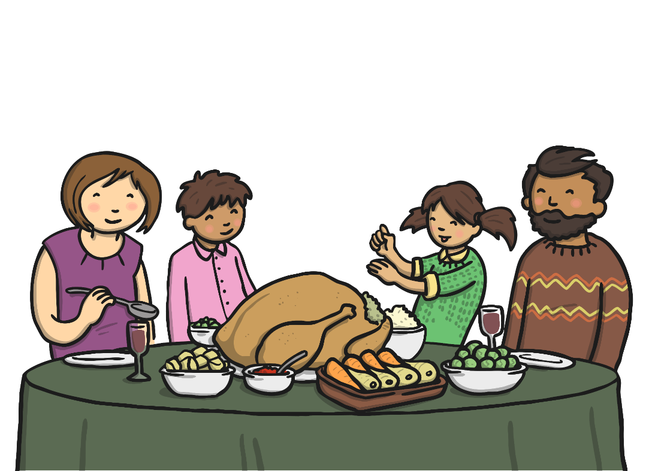
Questions
2
Questions are sentences that ask you something.
They end with a question mark.
Examples:
What did you have for dinner?
What is your favourite food?
Do you like chicken?
Write down as many questions as
you can that relate to this
picture.
Can you write an answer (a
statement!) for each of your
questions.

Slide 5
Extra Task for Year Twos: Look at the picture of the four people on the next slide. What do you think they are saying to each other? Write down some questions and statements.

Slide 7
Hopefully I will see you in the classroom for our next Grammar session Class 2! Mrs Dunkley

