Slide 1
Assessment without levels at Stathern
Wednesday 27th January 2016 – Parents’ Evening

Slide 2
Time line and key developments
A new national curriculum was published in 2014.
Statutory assessment arrangements will change in summer 2016 to align with its content and principles.
From September 2015, levels are no longer used for statutory assessments.
All year groups now being taught against new curriculum, teaching some content earlier than before. The old levels don’t match the new curriculum.
From summer 2016 the results of national curriculum tests Key stage 1 and 2 will be reported in the form of scaled scores.

Slide 4
Final report of the Commission on Assessment without levels 17th September 2015.
The levels system of assessment distorted the purpose of in-school assessment, particularly day-to-day formative assessment.
Too often levels became viewed as thresholds and teaching became viewed as going through thresholds instead of ensuring they were secure in the knowledge and understanding defined in the programmes of study.
Depth and breadth of understanding were sometimes sacrificed in favour of pace. Levels also used a ‘best fit’ model, which meant that a pupil could have serious gaps in their knowledge and understanding, but still be placed within the levels. This meant it wasn’t always clear exactly which areas of the curriculum the child was secure in and where the gaps were.
The disconnect between levels and the content of the national curriculum also meant that telling a parent his or her child was a level 4b, did not provide meaningful information about what that child knew and understood or needed to know to progress.

Slide 5
listen to Tim Oates from Cambridge Assessment talking about the reasons behind changes to assessment in the new curriculum and rationale behind moving away from levels. https://www.youtube.com/watch?v=-q5vrBXFpm0

Slide 6
Assessment is at the Heart of Teaching and Learning
Assessment provides evidence to guide and inform teaching and learning
Assessment provides the opportunity for pupils to demonstrate and review their progress.
Peer and self-assessment are essential skills
Assessment Outcomes Provide Meaningful and Understandable Information for:
Pupils in developing their learning
Parents in supporting children with their learning
Teachers in planning teaching and learning
School leaders and governors in planning and allocating resources
Government and agents of government

Slide 7
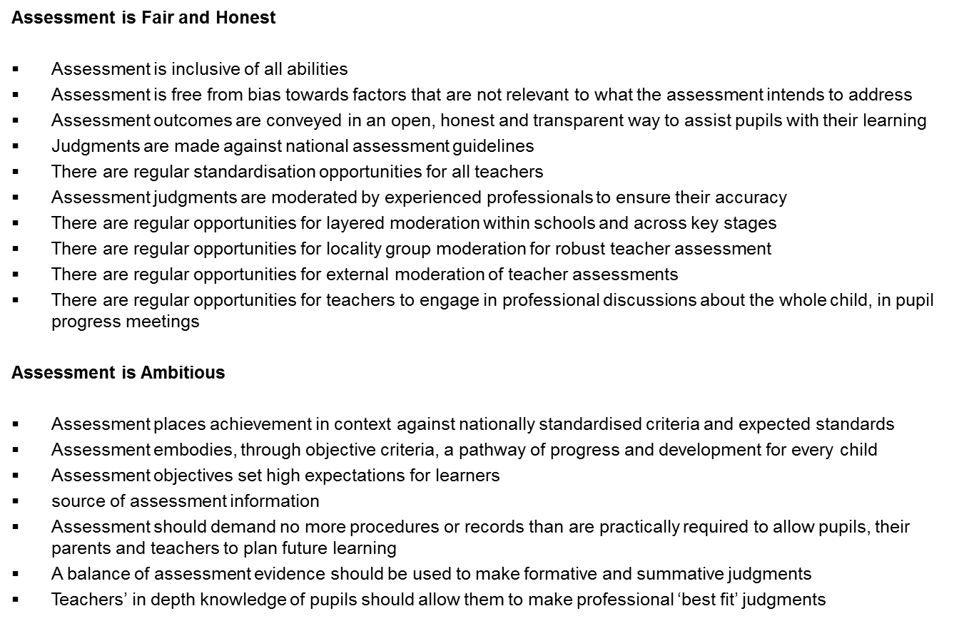

Slide 8
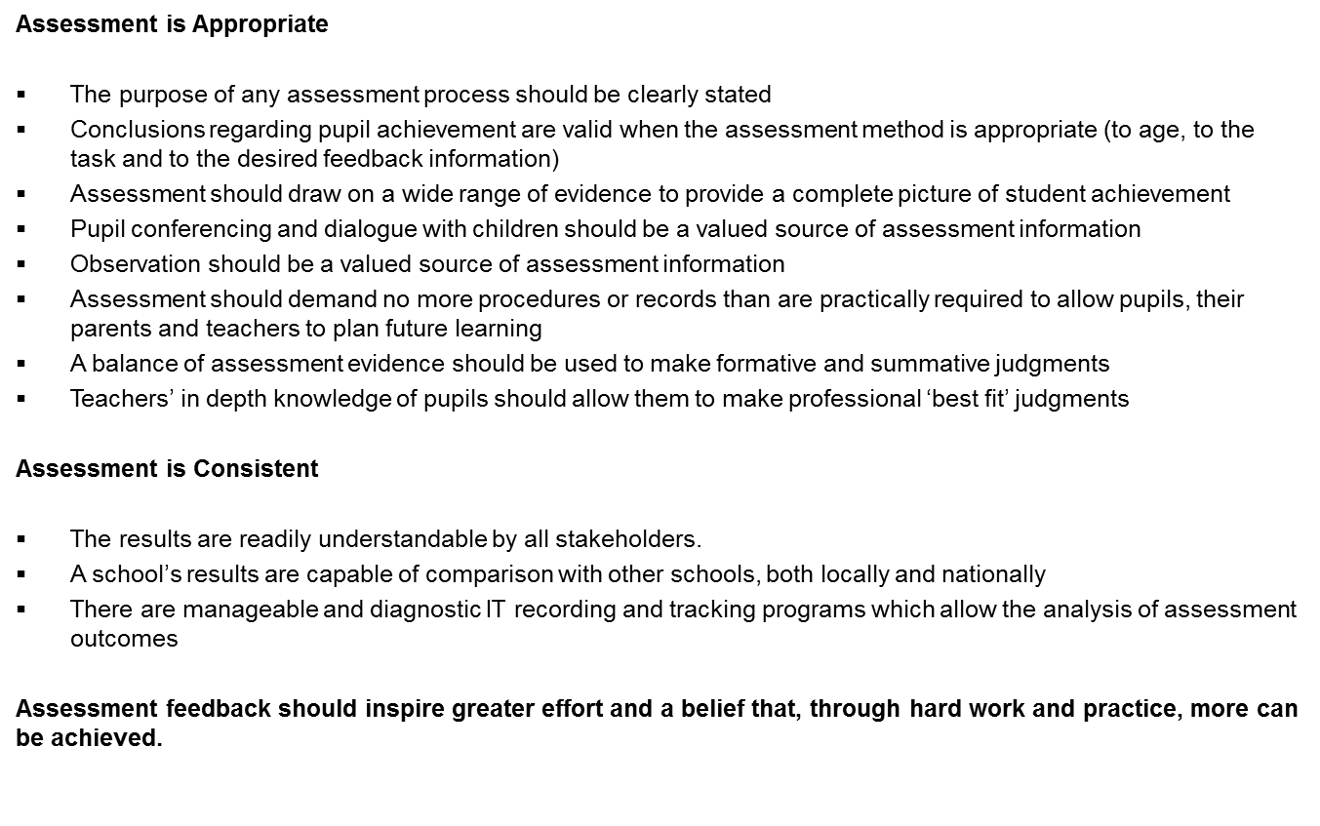

Slide 9
P…
Classroom Monitor – Tracking Attainment and Progress
The school has been using Classroom Monitor software to measure pupil attainment and progress since September this year.
To replace national levels Classroom Monitor has devised a system of ‘steps’
This performs the function of communicating progression and attainment in a simple format where the number of the level awarded is the same as the year group the pupil is currently in
These levels are split into 6 ‘steps’ within the year group

Slide 10
P…
Classroom Monitor – What are the steps?
Each year band has been broken down into six steps:
Some
Some +
Most
Most +
All
Exceeded
Beginning
Beginning +
Working Towards
Working Towards +
Secure
Exceeded

Slide 11
Classroom Monitor – Where should my child be?
This will obviously depend on the pupil’s ability level and how hard they work!
The expected standard at the end of each academic year will be ‘secure’ or ‘all’ (5th step)
BUT we will be tracking progress as well and each pupil will ideally make 6 ‘steps’ of progress from one year to the next
So a child who was ‘2s’ (Year 2 and ‘secure’) at the end of Y2, should be ‘3s’ by the end of Y3
You only need to be ‘secure or ‘all’ to move to the next band, not ‘exceeded’

Slide 12
P…
Classroom Monitor – What does each step mean?
The three broader sections may be thought of in these terms;
Beginning – Pupil learning is chiefly focussed on the criteria for the band. There may be minimal elements of the previous band still to gain complete confidence in
Working Within – Pupil learning is fully focussed on the criteria for the band. This is a teacher best fit decision but could be informed by statement assessments between around 40% and 70% achieved
Secure – Confidence in all of the criteria for the band. There may be pupil learning still focussed on gaining thorough confidence in some minimal elements but the broad expectations for the band have been met

Slide 13
P…
Classroom Monitor – What if they are working outside their age appropriate band?
Below – Children will continue to work within their age appropriate band until they are secure, even if they move year groups.
Above – Children will be expected to broaden and deepen their understanding through a range of applications and contexts within the age appropriate band NOT move to the band above.

