Slide 1
Spring Term
Week 1: Number Bonds
This maths powerpoint has 3 sessions included all to do with number bond. There are some videos to watch and each year group has a task to do for each session.

Slide 2
Session 1: Lesson objectives: To recall number bonds to 10 or 20 To review whole Part-Part Model
https://www.youtube.com/watch?v=ch7KzI3n2Zk
To practise chanting number bonds to 10 for fluency
To be able to recall number bonds to 10 or 20
To use a whole part-part model showing number bonds to 10 or 20

Slide 3
Number bonds to 10
Look at the next few slides and look at the pattern for number bonds to 10
Think about:
What is happening to each column?
What is happening to the numicon shapes?

Slide 4
Show Answer
Number Bonds to 10
=
+
0
10
+
=
10

Slide 5
Show Answer
Hide Answer
Number Bonds to 10
+
=
?
9
+
=
10

Slide 6
Show Answer
Hide Answer
Number Bonds to 10
+
?
=
8
+
=
10

Slide 7
Task 1: Look at the pattern below can you complete it.
Year 2s use your number bonds
to 10 and write number bonds
to 100
10 + 0 = 100 + 0 = 100
9 + 1 = 90 + 10 = 100
8 + 2 = ?? + ?? = 100
? + ? =
Helpful hint: Use 10 counters or pieces of pasta and divide into two groups then write as an equation.

Slide 8
Look at the list of equations. Did you find them all?
What happens if we swop the numbers around?
10 + 0 = 10 0 + 10 = 10
9 + 1 = 10 1 + 9 = 10
8 + 2 = 10 2 + 8 = 10
7 + 3 = 10 3 + 7 = 10
6 + 4 = 10 4 + 6 = 10
5 + 5 = 10 5 + 5 = 10

Slide 9
Task 2: Year 1 Independent
Purple Group

Slide 10
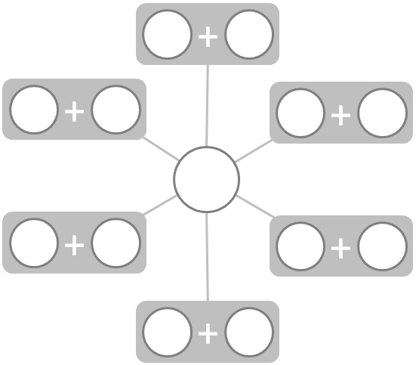
Task 2: Year 2 Independent
10
100

Slide 11
Session 2 Lesson objective: To use number bonds to 10 and write number bonds to 20
Recap number bonds to 10
https://www.youtube.com/watch?v=ch7KzI3n2Zk
Sing the following song for number bonds to 20
https://www.youtube.com/watch?v=h6udqW6VhWg

Slide 12
Task 1: Use number bonds to 10 to make Number bonds to 20
Add 10 stick to each side of the equation
Write a new equation underneath the present one
Move the ten stick to make another equation that keeps the scales balanced
8 + 2 = 10
+ =

Slide 13
Make this equation into Number Bond to 20 by adding 10 to each side
+
0
=
+
10
=
20

Slide 14
What do we need to add to this equation to make it correct.
+
?
=
+
=
20
10

Slide 15
What do we need to add to this equation to make it correct.
+
?
=
+
=
20
10

Slide 16
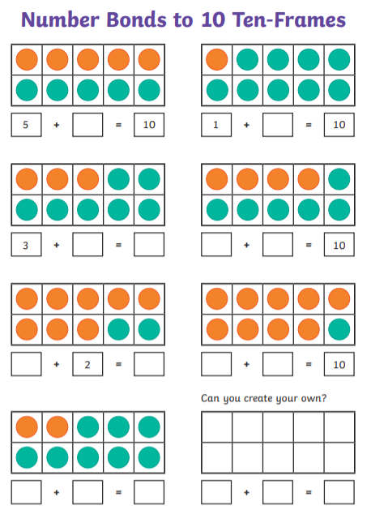
Task: Year 1 Complete a worksheet for number bonds to 10 and 20

Slide 17
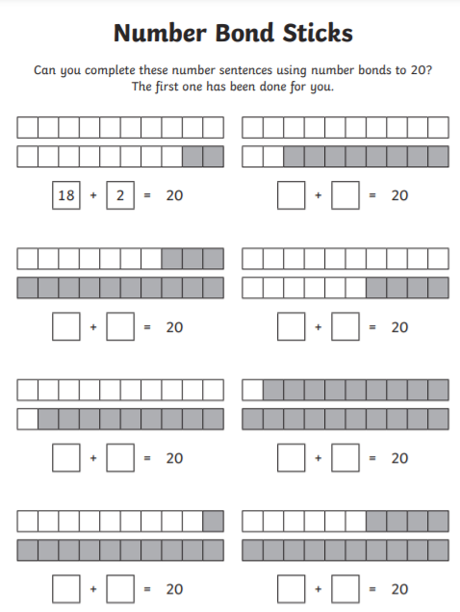
Number bonds to 20

Slide 18
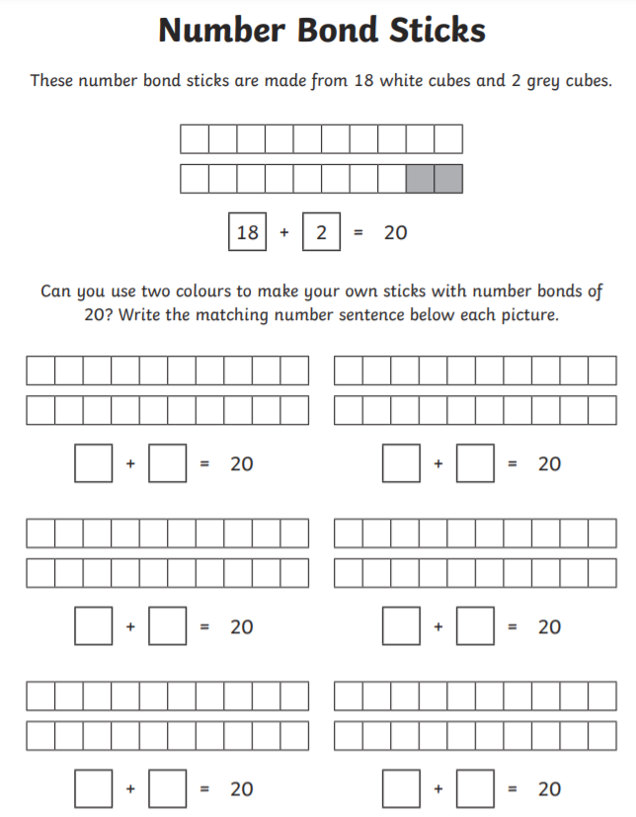
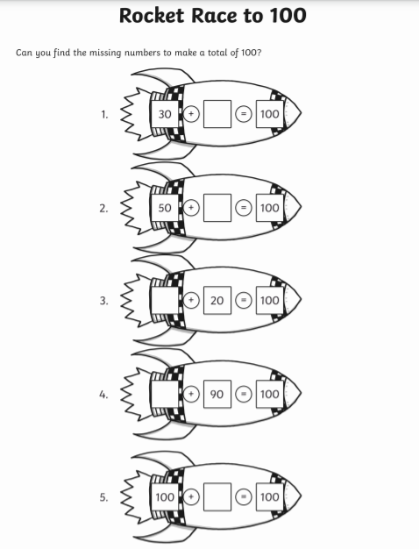
Task: Year 2 Complete a worksheet for number bonds to 20 and 100

Slide 19
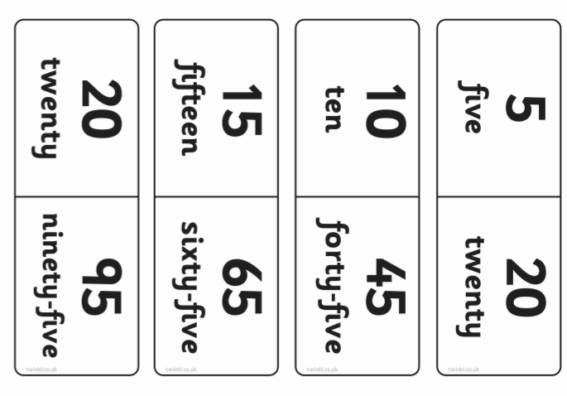
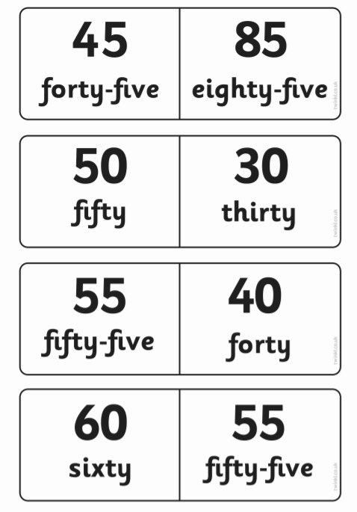
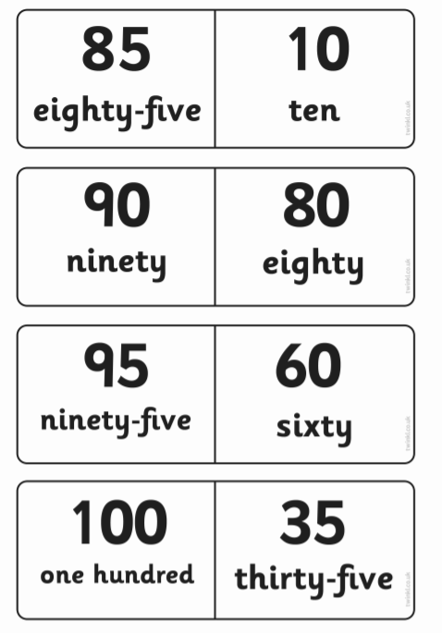
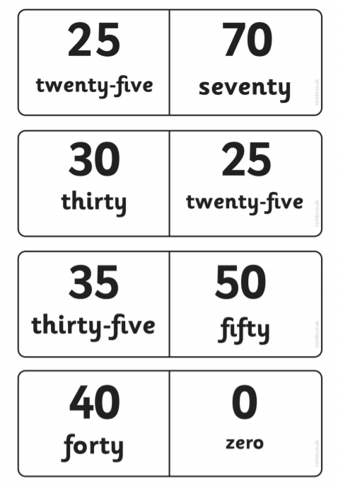
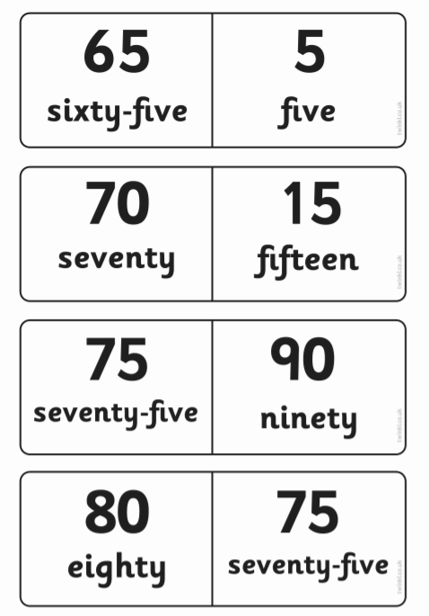
Year 2 – cut out the dominoes and match up the dominoes that make 100

Slide 20
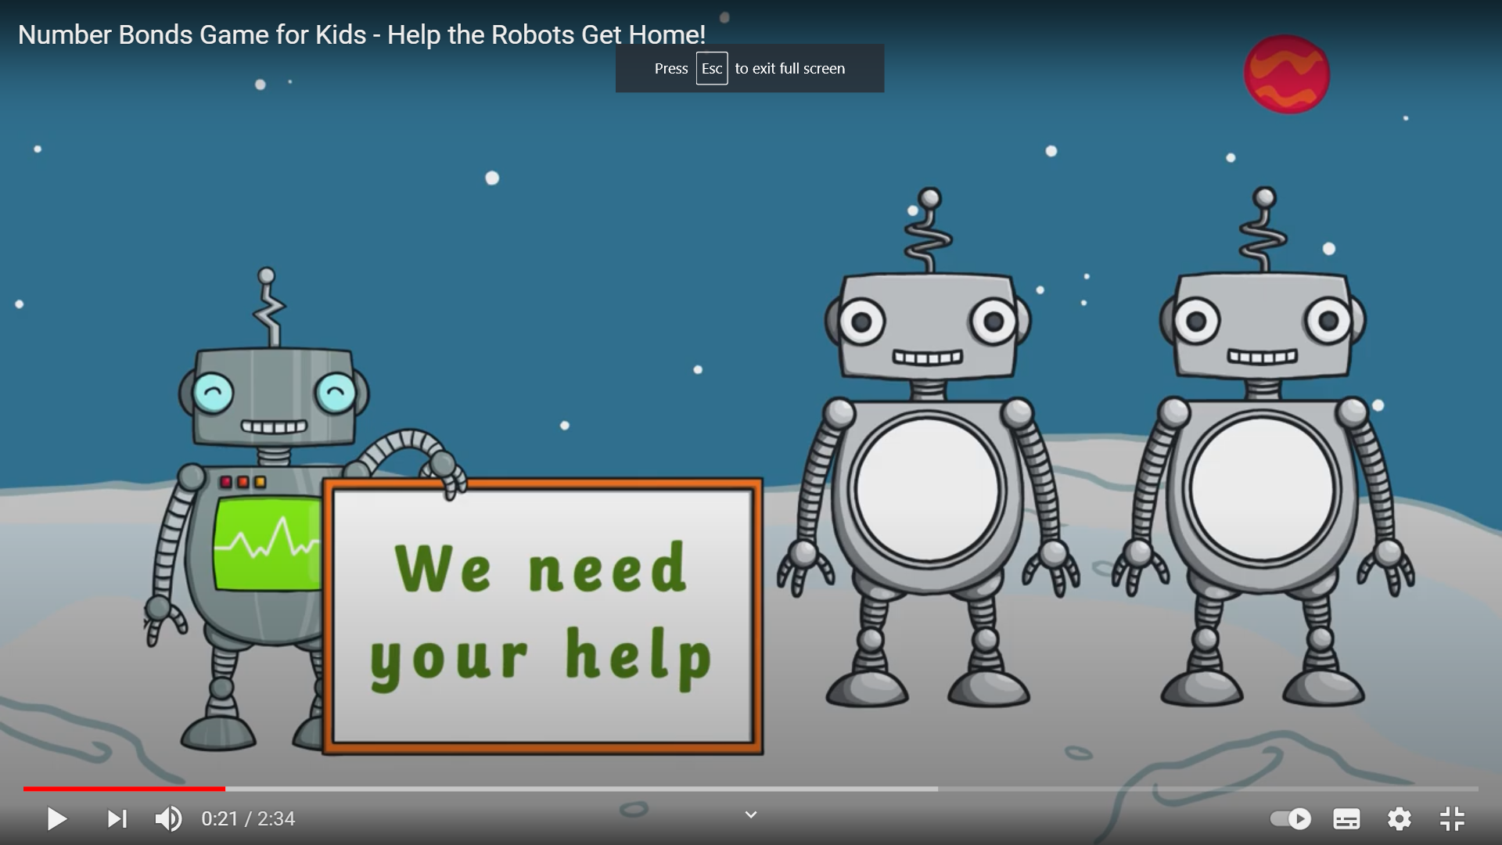
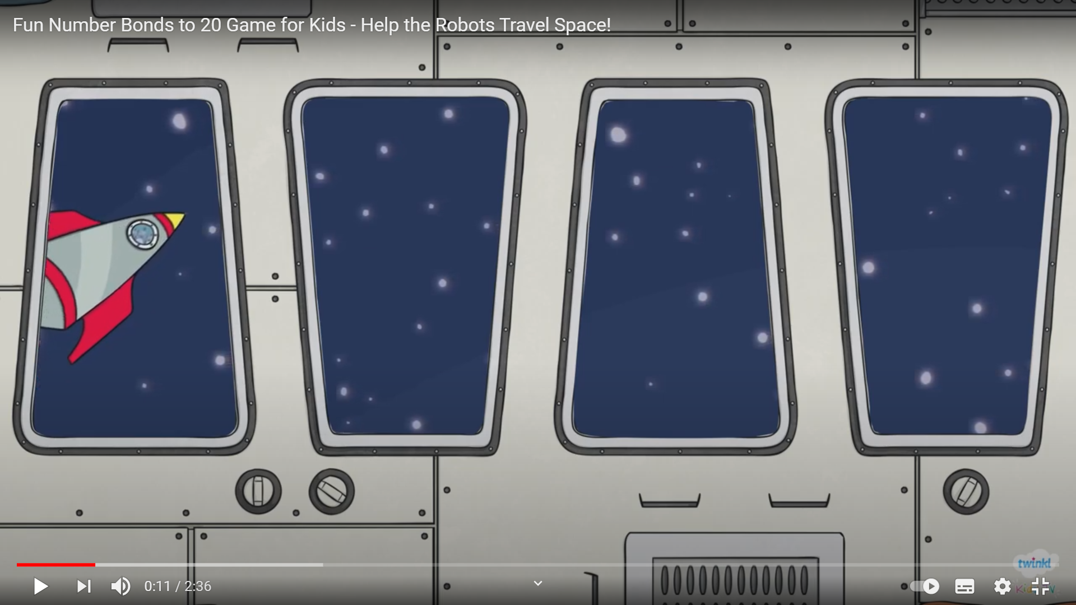
Session 3: Space game: Stop the rocket from crashing by working out number bonds to 10 and 20
https://www.youtube.com/watch?v=gpqnQifNYlE
https://www.youtube.com/watch?v=UuhEU56lzpc

Slide 21
Session 3: Using a part-part whole model
Watch the video for part- part whole model
https://vimeo.com/461356119

Slide 22
Task 1 – Year 1: Independent Purple Group
Draw 6 whole part-part models and write the equations in them
10 + 0 = 10
9 + 1 = 10
8 + 2 = 10
7 + 3 = 10
6 + 4 = 10
5 + 5 = 10

Slide 23
Task 1 – Year 1: Independent
Draw 6 whole part-part models and write the equations in them
Write the number bonds to 10 using the part whole model
Use the counters to help you

Slide 24
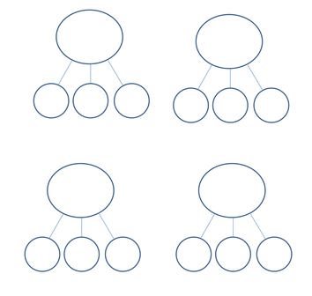
Task 1- Year 2s: Independent
Write some equations for number bonds to 20
Draw 6 whole part-part models and write the equations in them
Use 3 numbers to make 20 on these part- part- part whole model
10 + 10 = 20

Slide 25
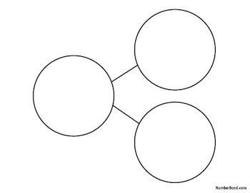
Task 2: Year 2s Write equations to 100 using multiples of 10 or 5 and write them in the part whole model

