Slide 1
Phonics Home Learning

Slide 2
Welcome to your Phonics Powerpoint
Purple Group
Week 2 29.2.2021
er and ure
There will be two live lessons this week with Mrs Waller, these will be on Monday and Wednesday at 10.00am. Tuesday and Thursday will have work set for the sounds learnt during the live lessons.

Slide 3
Week 2 spellings
pure boxer
cure flower
vulture runner
picture farmer
mixture summer

Slide 4
Monday: Learning the `er` sound
Teams meeting with Mrs Waller at 10.00 to learn two new phonemes – invite sent.

Slide 5
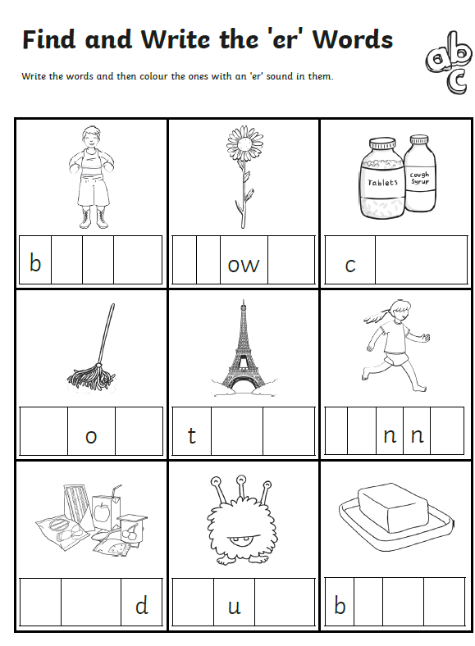
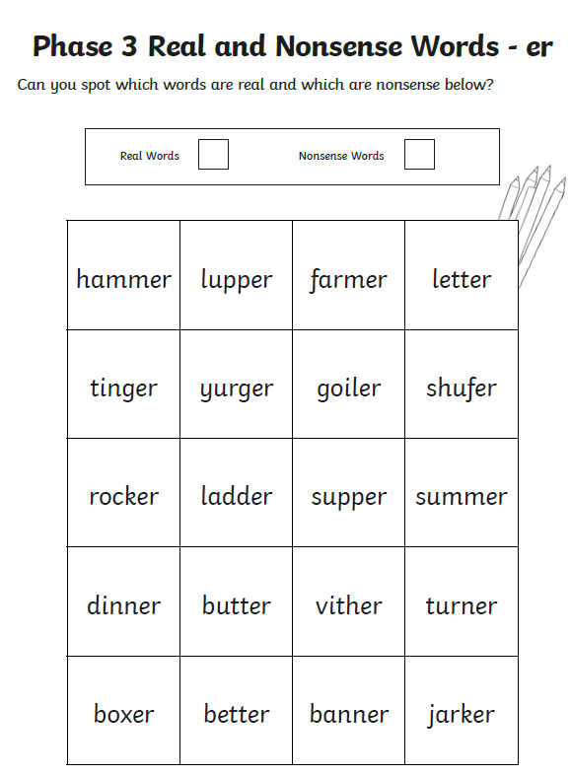
Tuesday Tasks: New sound `er`

Slide 6
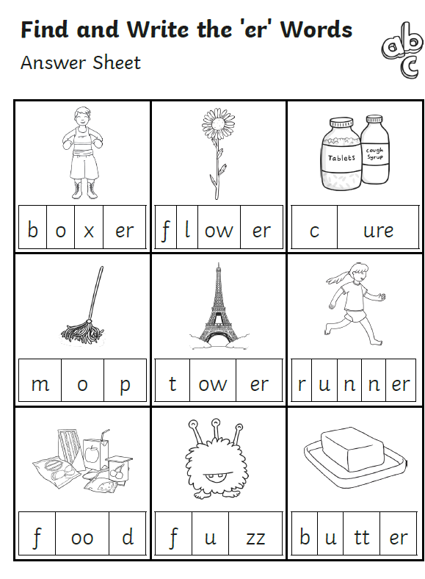

Slide 7
Wednesday: Learning the digraphs `ure`
Teams meeting with Mrs Waller at 10.00 to learn two new phonemes – invite sent.

Slide 8
Thursday Tasks: Tasks for `ure`

Slide 9
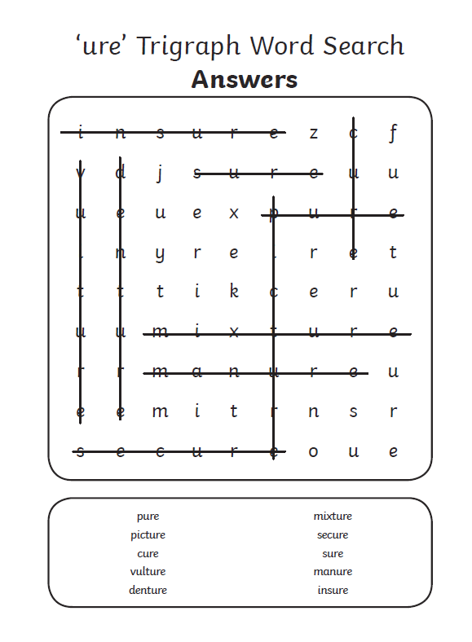

Slide 10
Extra – Practise your phonics on the website Phonics Play for the weekly sounds. https://www.phonicsplay.co.uk/resources
Purple Group – Phase 3
Set 1-7 – consonant digraphs

