Slide 1
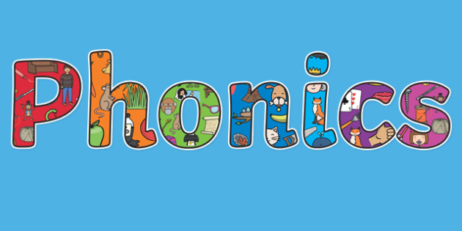
Phonics Home Learning

Slide 2
Welcome to your Phonics Powerpoint
Purple Group
WB 18.1.2021
ai, ee, igh, oa
The first slide of the powerpoint has a video by Mr. Teach who will teach you about the sounds for the week. Each day there is one of the sounds for you to practise.

Slide 3
Monday: Learning the digraphs `ai` and `ee`
Teams meeting with Mrs Waller at 9.30 to learn two new phonemes – invite sent

Slide 4
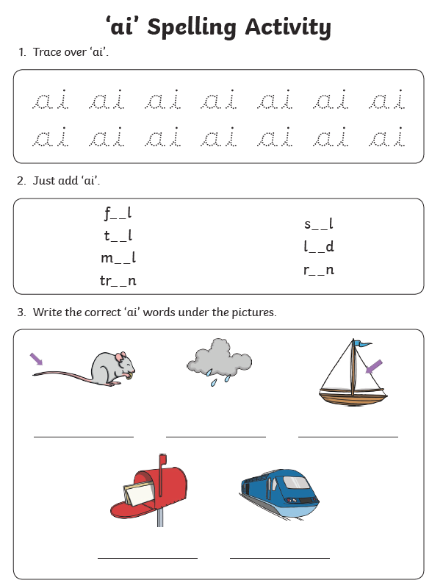
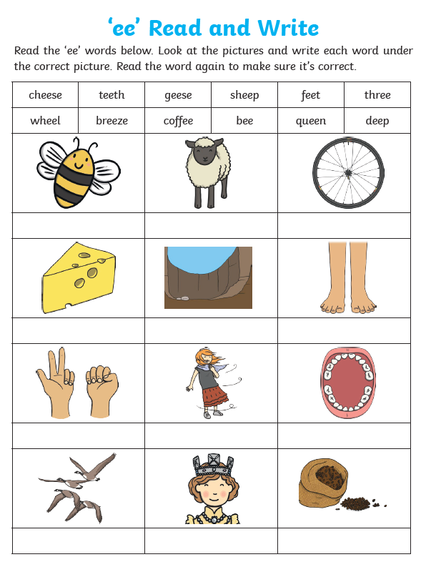
Monday Tasks: To explore the ai and ee digraph
Task 1
Task 2

Slide 5
Tuesday: Reviewing the sounds `igh` and `oa`
Watch the video to learn the sounds igh and oa.
https://www.youtube.com/watch?v=0QwrkowksKk

Slide 6
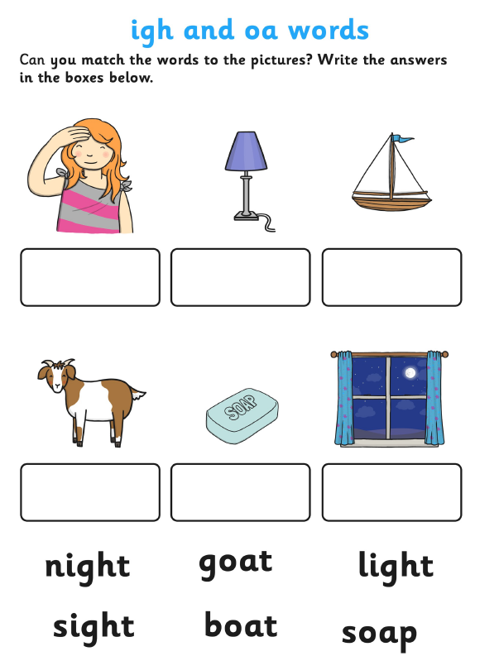
Tasks: Complete the tasks below for `igh` and `oa`
Task 1
Task 2

Slide 7
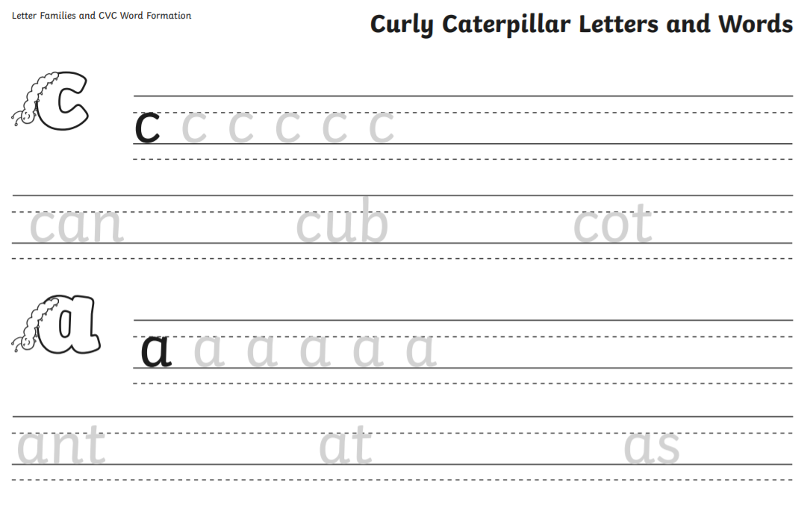
Wednesday: Practise your handwriting

Slide 8
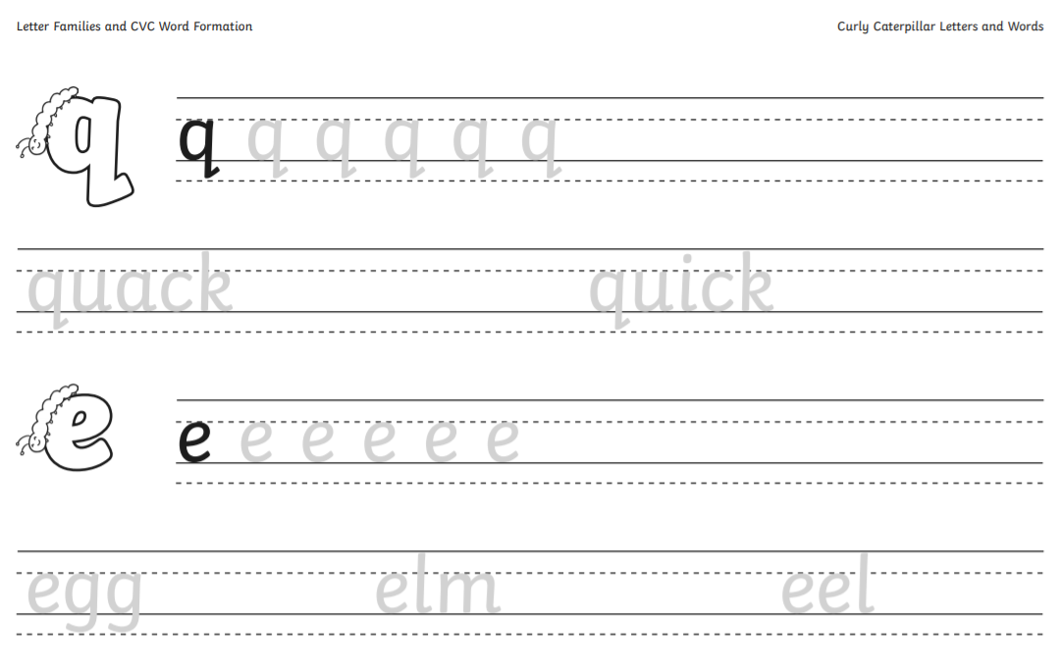

Slide 9
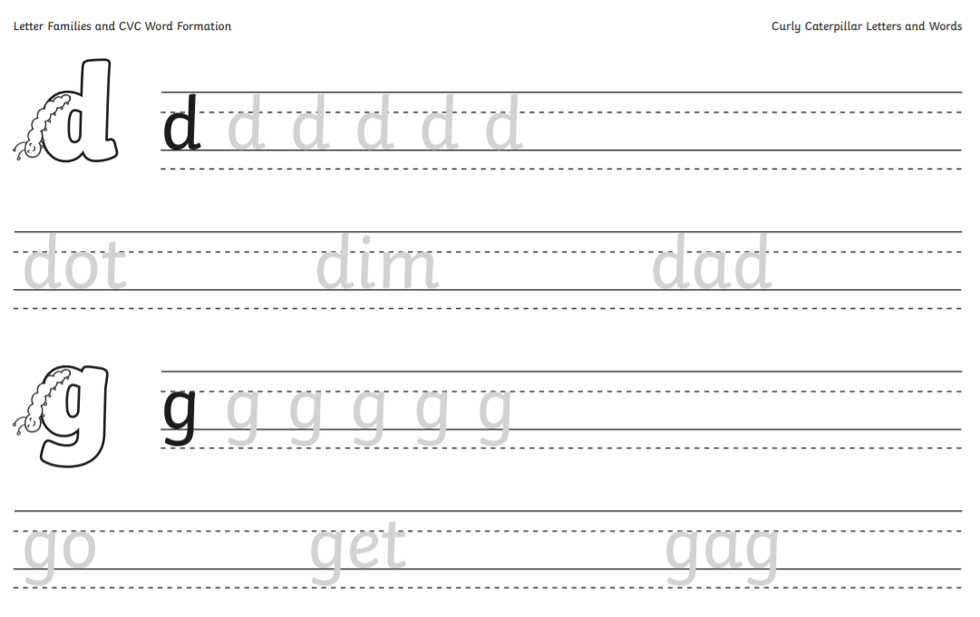

Slide 10
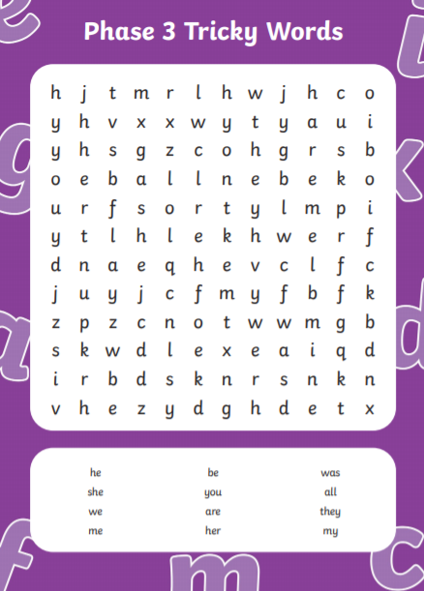
Thursday: Practise your tricky words

Slide 11
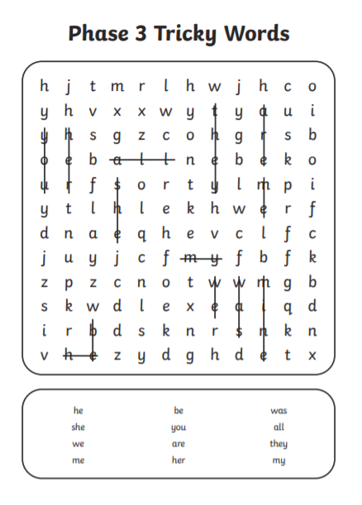

Slide 12
Extra – Practise your phonics on the website Phonics Play for the weekly sounds. https://www.phonicsplay.co.uk/resources
Purple Group – Phase 3
Set 1-7 – consonant digraphs

