Slide 1
Spring Term
Week 2
Year 2s Multiplication
WB 11.1.2021

Slide 2
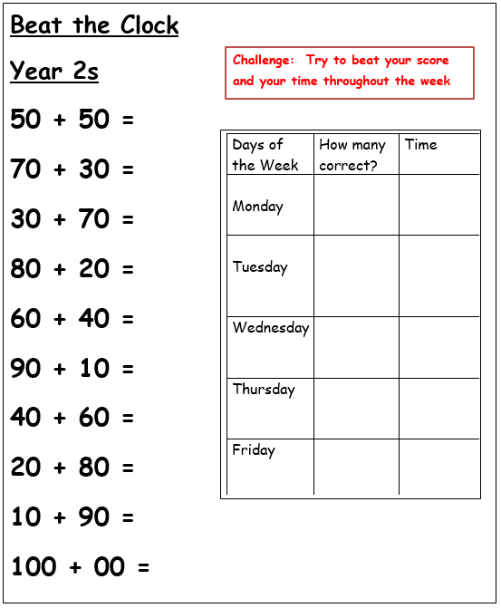

Slide 3
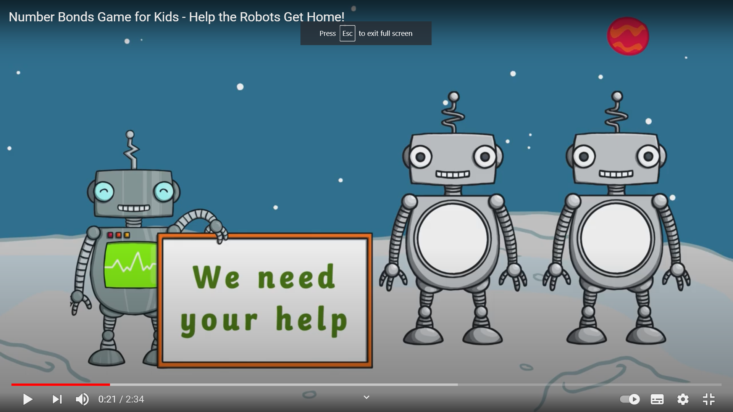
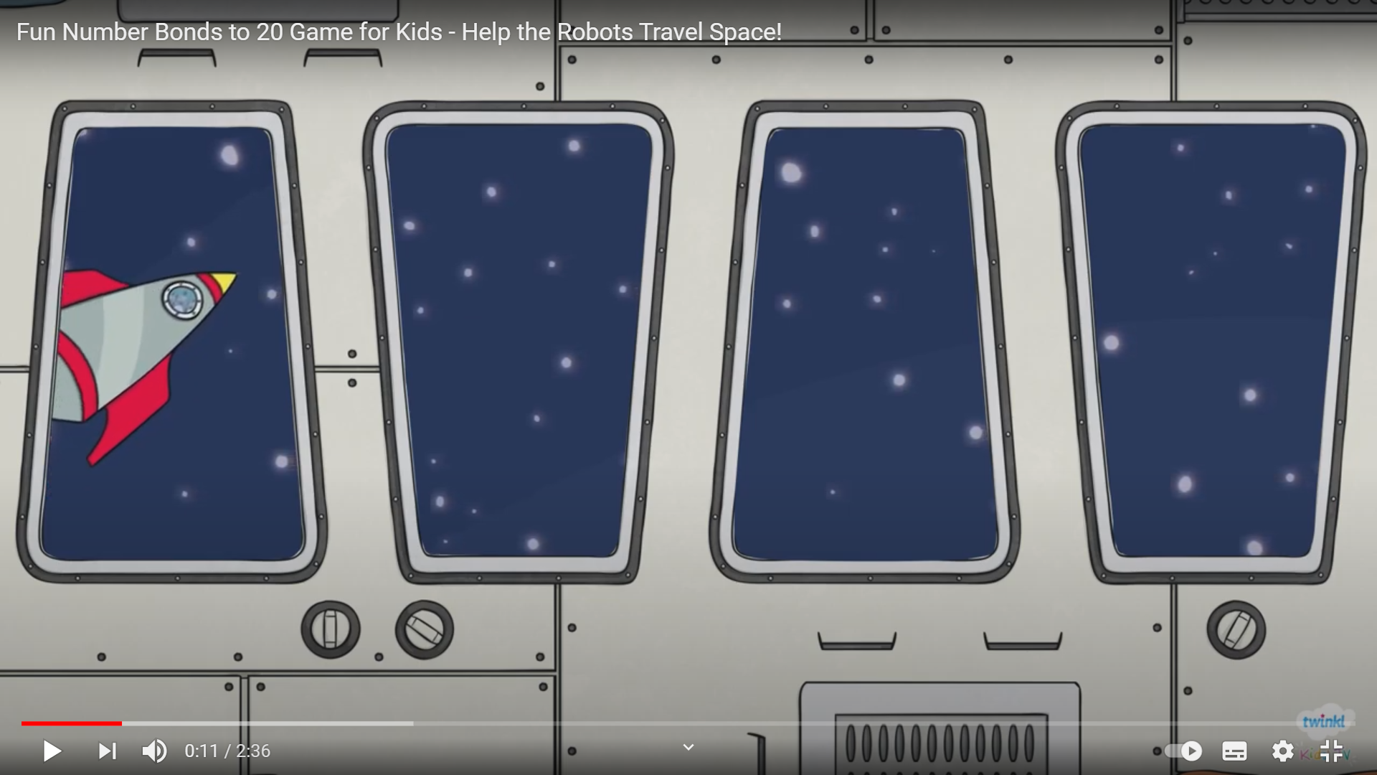
Monday Warm–up – choose one of the games below
https://www.youtube.com/watch?v=gpqnQifNYlE
https://www.youtube.com/watch?v=UuhEU56lzpc

Slide 4
Monday: Lesson objective: To understand equal and unequal groups
Watch the video below and follow the activities that you are asked to do.
https://youtu.be/7MmjQ_-XlIg?list=PLQqF8sn28L9y5AGykvQTeUZw_Snz68jm7

Slide 5
Task 1 Complete the following activities for equal or unequal groups

Slide 7
Task 2: Practical Activity – choose an object that you could make equal or unequal groups with and create a design (You could use lego, potatoes, leaves, sponges – be creative)

Slide 8
Something a little more challenging for those who wish to have a go.

Slide 9
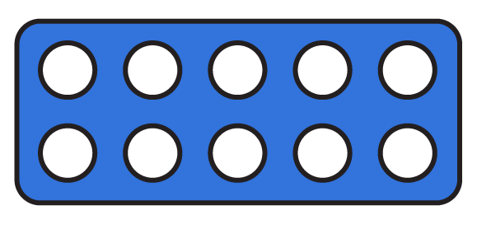
To be able to make equal groups by sharing
Starter:
Which one doesn’t belong?
Explain your answer.

Slide 10
To be able to make equal groups by sharing
Answers
Starter:
Which one doesn’t belong?
The straws representation doesn’t belong as it represents three groups of ten, whereas the other representations all show four groups of ten.

Slide 11
To be able to make equal groups by sharing
Activity 1:
Share the apples equally between the baskets and complete the sentences below:
Complete sentences about 8 baskets:
In total, there are __ apples.
There are __ baskets.
There are __ apples in each basket.
In total, there are __ apples.
There are 8 baskets.
There are __ apples in each basket.

Slide 12
To be able to make equal groups by sharing
Answers
Activity 1:
Share the apples equally between the baskets and complete the sentences below:
Complete sentences about 8 baskets:
In total, there are 16 apples.
There are 4 baskets.
There are 4 apples in each basket.
In total, there are 16 apples.
There are 8 baskets.
There are 2 apples in each basket.

Slide 13
To be able to make equal groups by sharing
Talking Time:
Call twelve children to the front of the class.
How many people would be in each group if we made:
two groups?
three groups?
four groups?
six groups?

Slide 14
To be able to make equal groups by sharing
Answers
Talking Time:
Call twelve children to the front of the class.
How many people would be in each group if we made:
two groups? Six people in each group.
three groups? Four people in each group.
four groups? Three people in each group.
six groups? Two people in each group.

Slide 15
Tuesday Warm–up – Complete the equations below

Slide 16
Answers

Slide 17
Tuesday - Lesson objective: To consolidate and use equal and unequal groups
Watch Video 2
https://youtu.be/aLOTi6MB1rg?list=PLQqF8sn28L9y5AGykvQTeUZw_Snz68jm7
Play the quiz on the following link
https://www.quizshed.com/en-gb/browse/QNTCLTO

Slide 18
Something a little more challenging for those who wish to have a go.

Slide 21
Wednesday Warm up: Complete the equations below

Slide 22
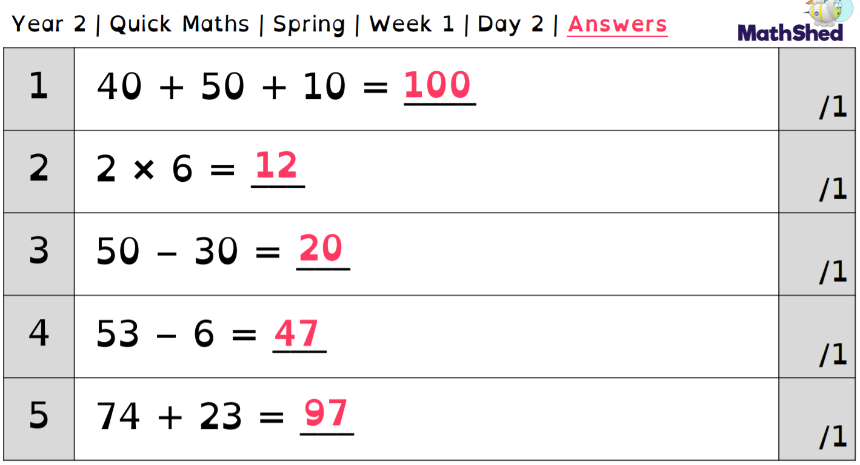
Answers

Slide 23
Wednesday – objectives: To review and understand repeated addition
We have completed repeated addition activities in Year 1, today you are going to review and consolidate your understanding before we move on to using the multiplication symbol.
Watch the video below and follow the instructions from the online teacher.
https://youtu.be/k_tfKEIE85A?list=PLQqF8sn28L9y5AGykvQTeUZw_Snz68jm7

Slide 24
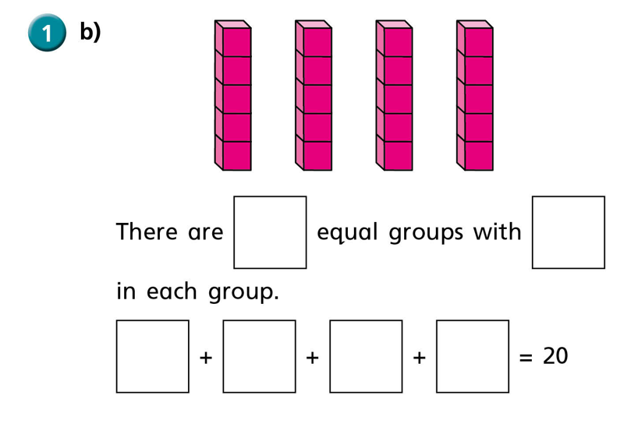
Task : Complete the following activities

Slide 25
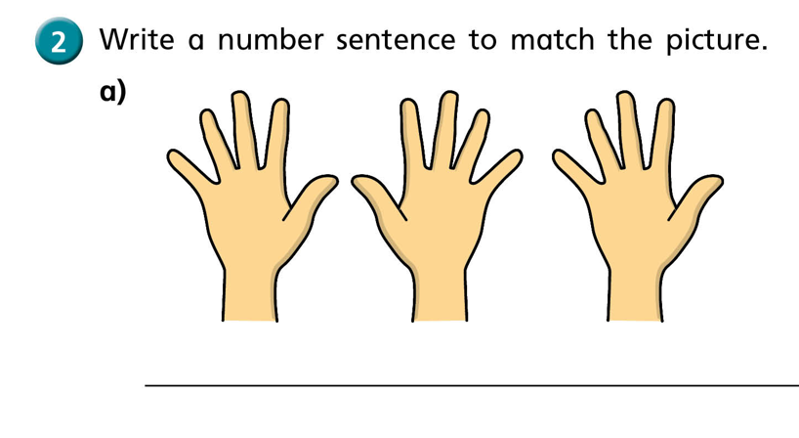
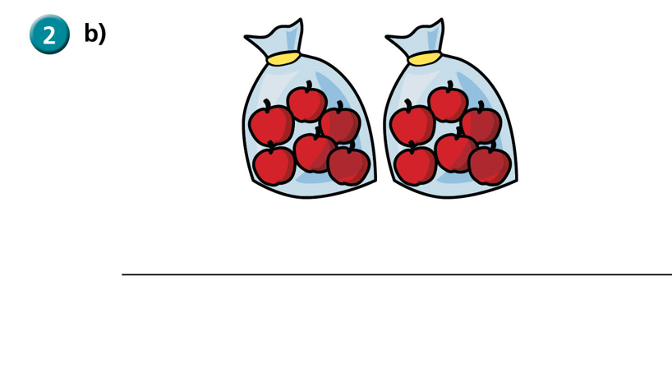

Slide 26
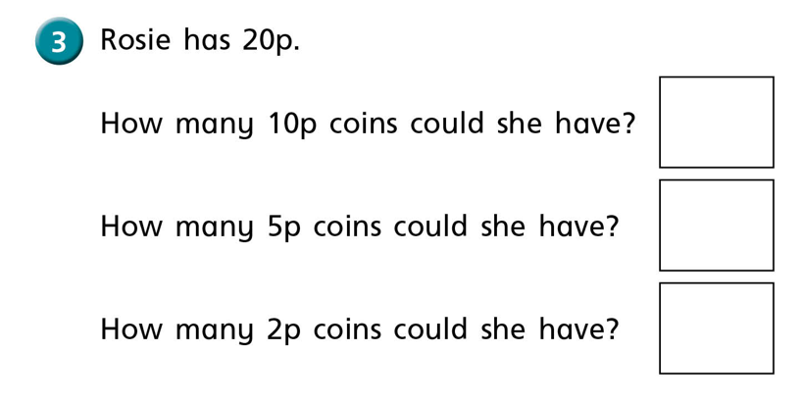
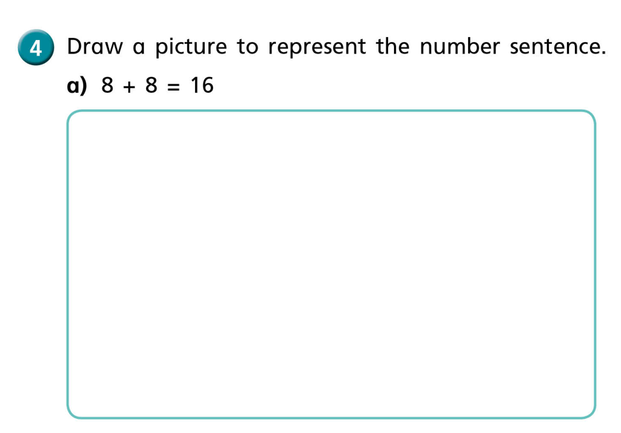

Slide 27
Something a little more challenging for those who wish to have a go.

Slide 28
Deep Diving Problems
Hardest problems
Easiest problems
Harder problems

Slide 29
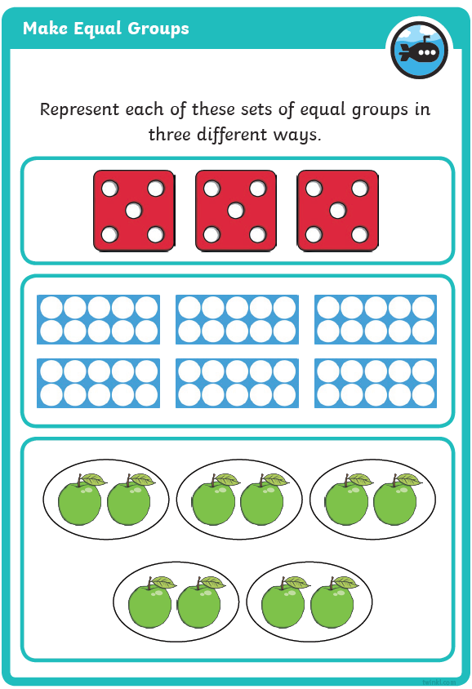
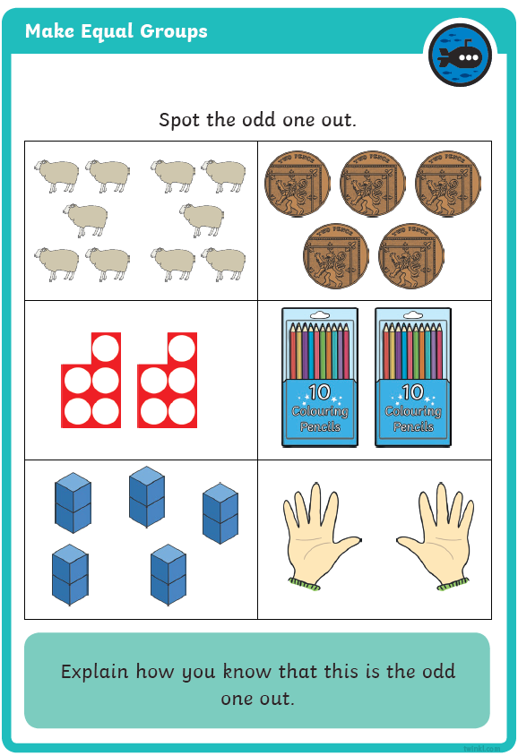
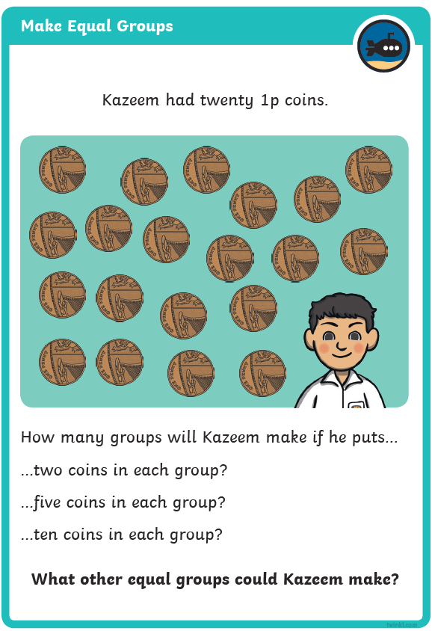

Slide 30
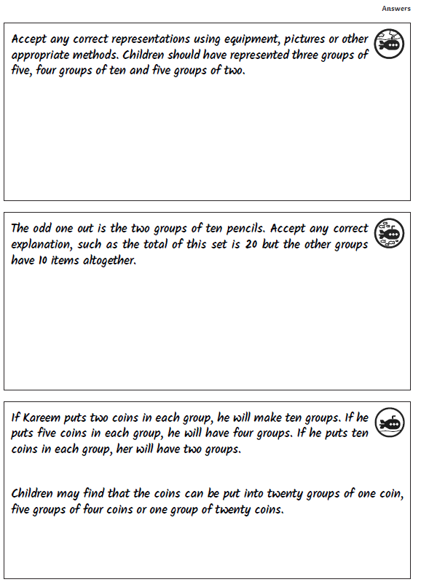

Slide 31
Thursday Warm up: Practise your 2x, 5x, and 10x tables
Use the BBC songs to help you practise
2x
https://www.bbc.co.uk/teach/supermovers/ks1-maths-the-2-times-table-with-bridget-the-lioness/zrrx92p
5x
https://www.bbc.co.uk/teach/supermovers/ks1-maths-the-5-times-table/zhbm47h
10x
https://www.bbc.co.uk/teach/supermovers/ks1-maths-the-10-times-table-with-webster-the-spider/zm32cqt
TT rockstars has been set up for you to practise your tables

Slide 32
Thursday – objectives: To use the multiplication symbol X
We have jumped a couple of videos so the beginning might mention the previous lesson but that won`t be a problem, this session is to relate the repeated addition to the multiplication symbol X
Once again, watch the online teacher on this video and complete the activities she asks you to do.
https://youtu.be/DmekUT4_Lkc?list=PLQqF8sn28L9y5AGykvQTeUZw_Snz68jm7

Slide 33
Task 1: Complete the sheets below

Slide 34
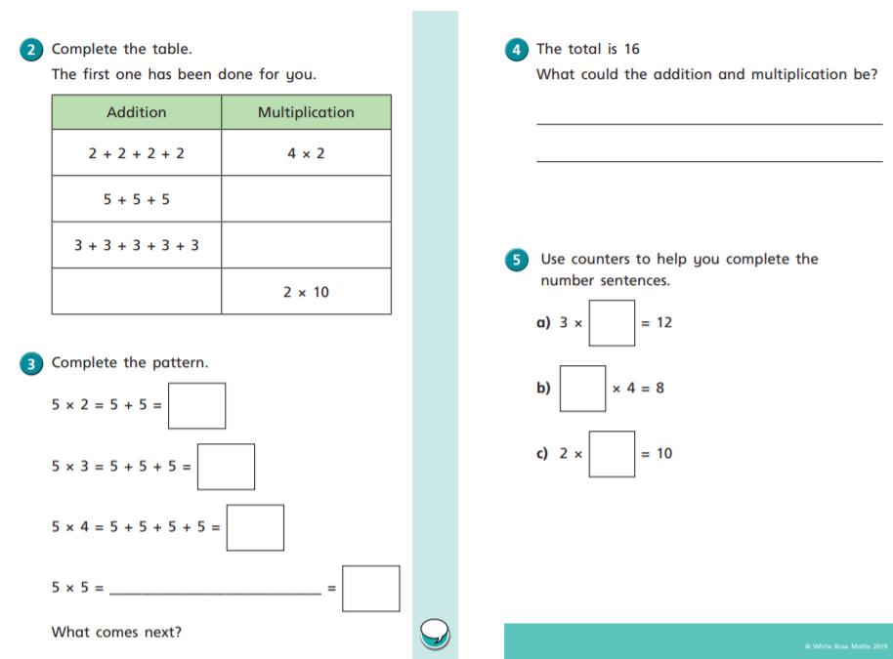

Slide 35
Something a little more challenging for those who wish to have a go.

Slide 36
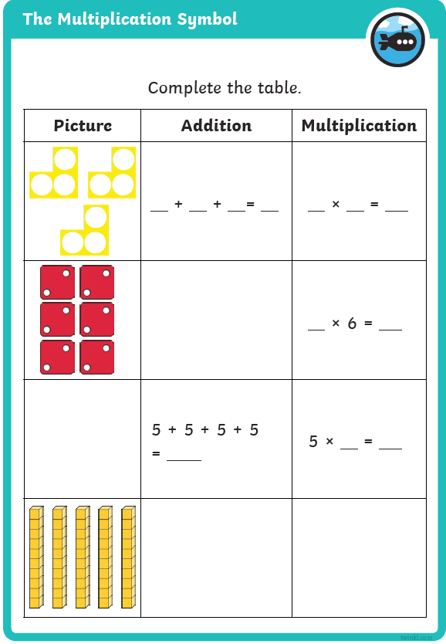
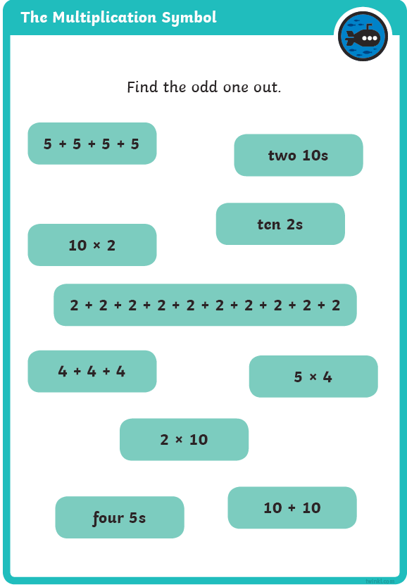
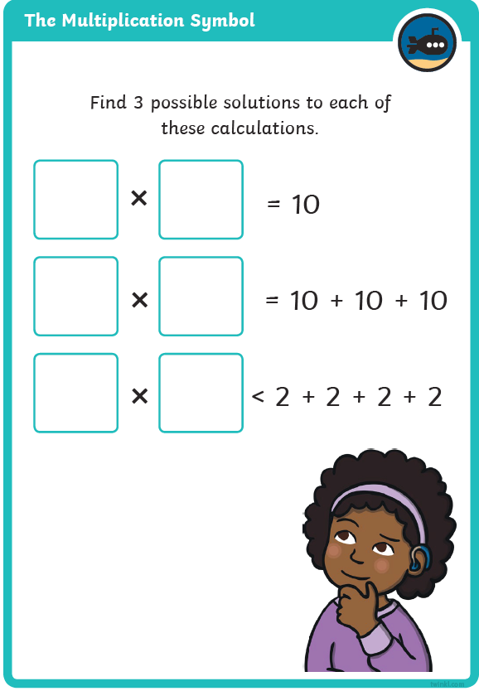
Choose one of these problems or more if you wish.

Slide 37
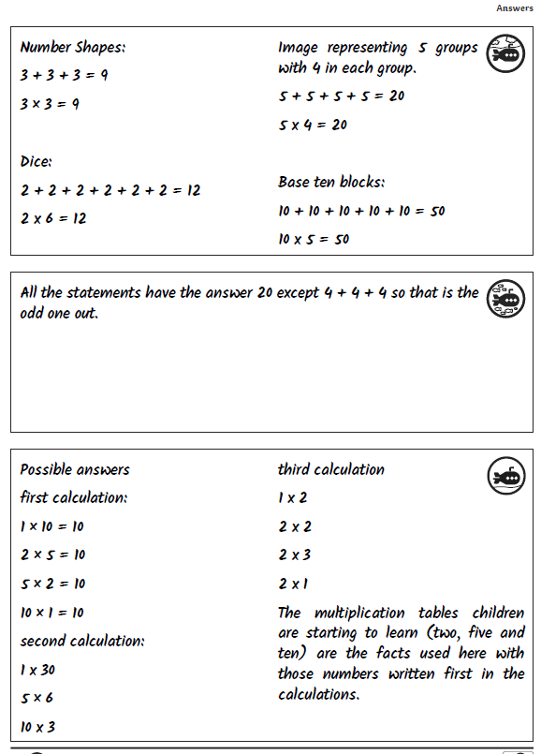

Slide 38
Something even more challenging for those who wish to have a go.

