Slide 1
Monday and Tuesday: To understand the structure of a story
Objective:
To listen carefully to a story.
To answer questions about the characters and setting.
To predict what might happen in the story.

Slide 3
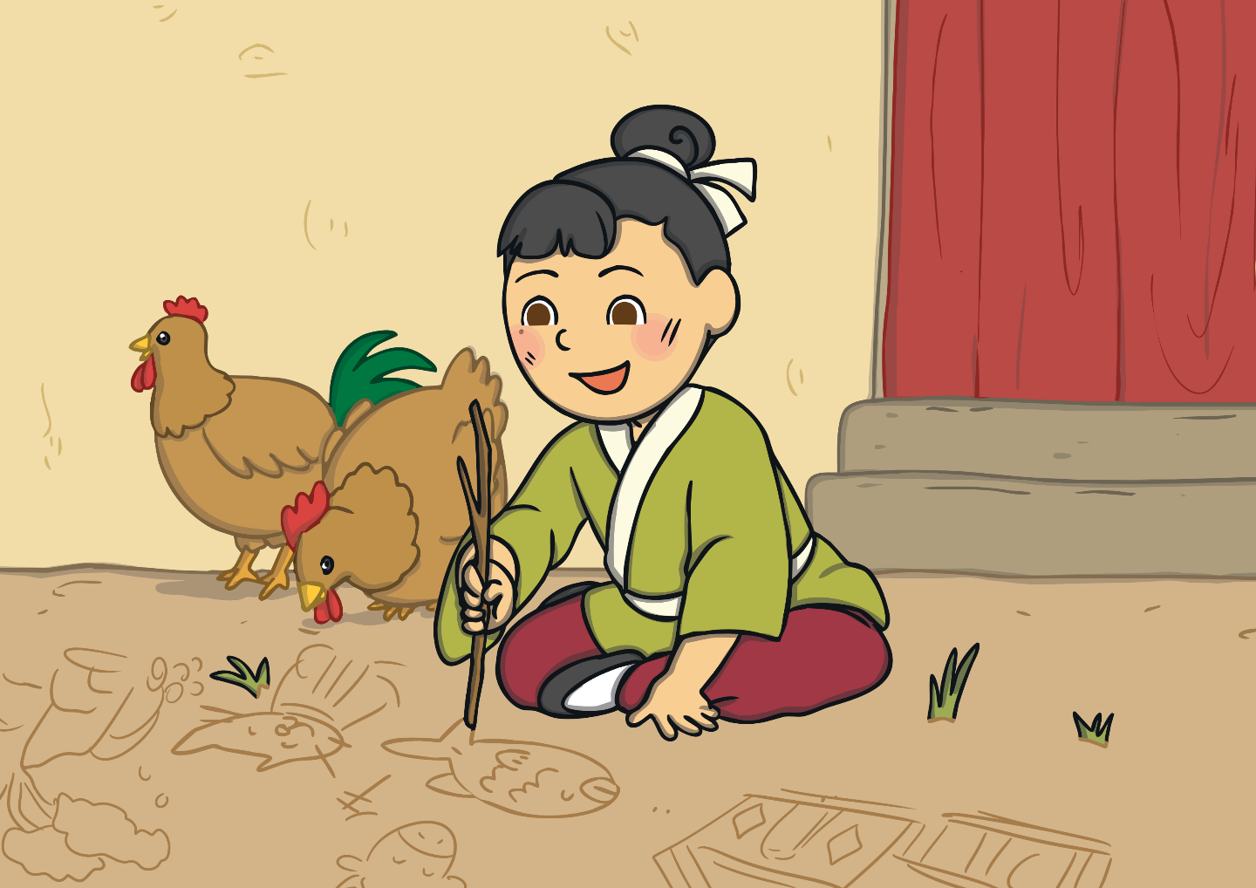
Once there lived a young boy named Ma Liang. He was very poor and very kind. Ma Liang loved drawing and drew pictures everywhere.

Slide 4
One night, when Ma Liang was asleep in bed, he dreamt that an old man gave him a magic paintbrush. In his dream, the old man asked Ma Liang to use the magic paintbrush to help poor people.

Slide 5
When Ma Liang woke the next morning, he found the magic paintbrush on his desk.

Slide 6
Where do you think our story is set?
Why do you think that? What clues are there?
What characters have we met so far? Are they good or bad characters?
Do you think the old man is real or in Ma Liang`s dreams?
Pause while you think and write down your answers.
When complete move onto the next slide and start the video again.

Slide 7
Monday task:
To predict what might be drawn with the magic paintbrush
Year 1
Draw and label what you think Ma Liang might draw with the magic paintbrush.
Year 2
Draw what you think Ma Liang might draw and write sentences to say how he could use each object to help the poor people out.

Slide 8
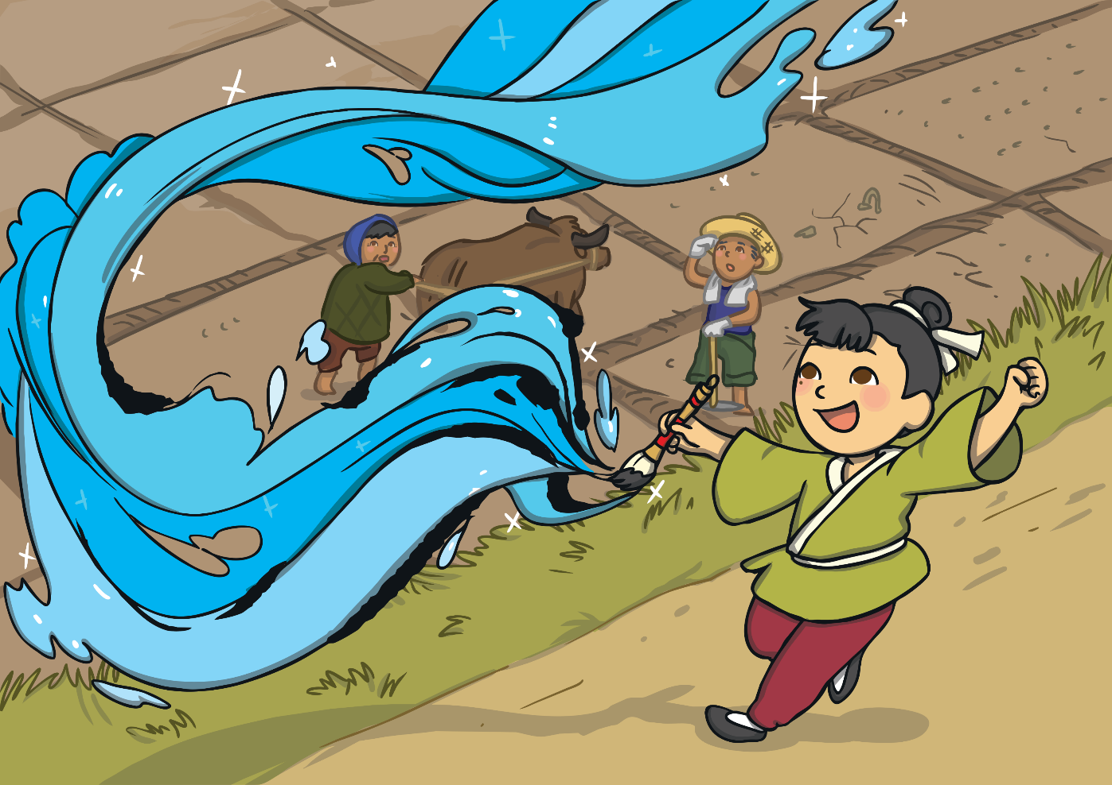
Ma Liang did as the old man had asked and used the paintbrush to help poor people. Ma Liang spotted a dry field with no water for the crops to grow, so he used his paintbrush to paint a river.

Slide 9
The river came to life! The poor people collected water from the river and used it to help the crops in their fields to grow.

Slide 10
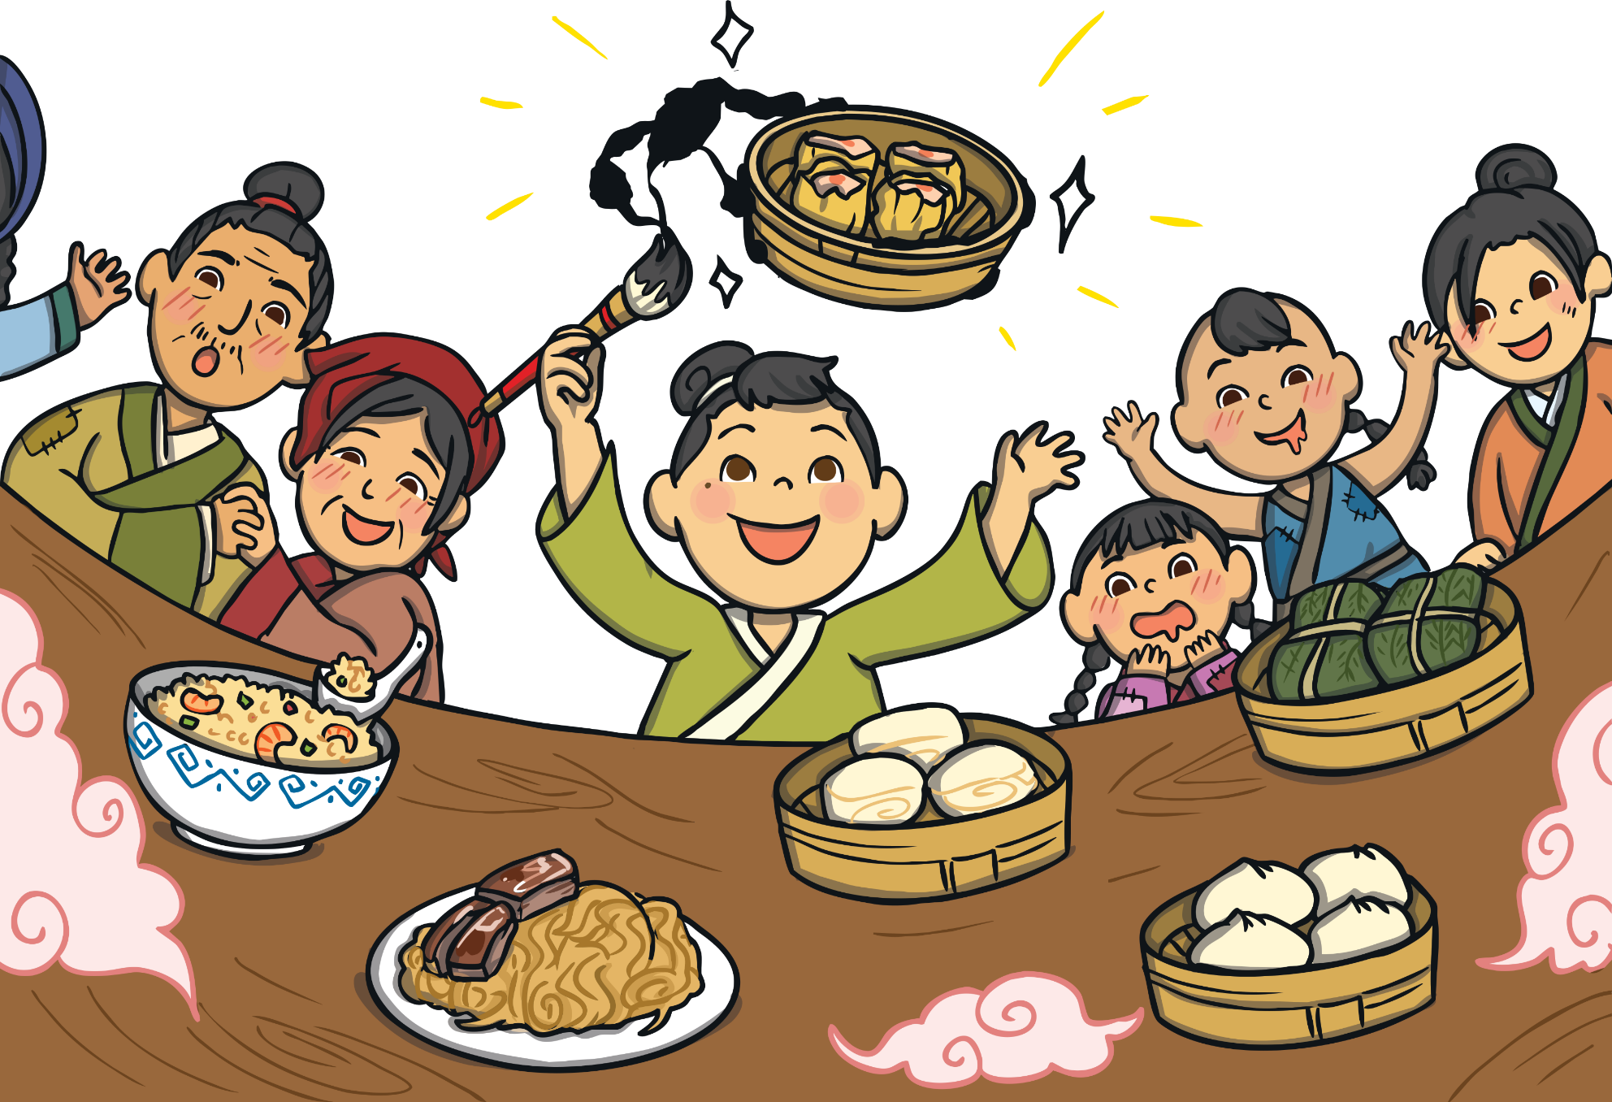
Ma Liang saw some farmers. He noticed that they worked really hard, but they still struggled to feed their families. He used his magic paintbrush to paint more food for them to eat. Everyone he helped was very grateful to Ma Liang.

