Slide 1
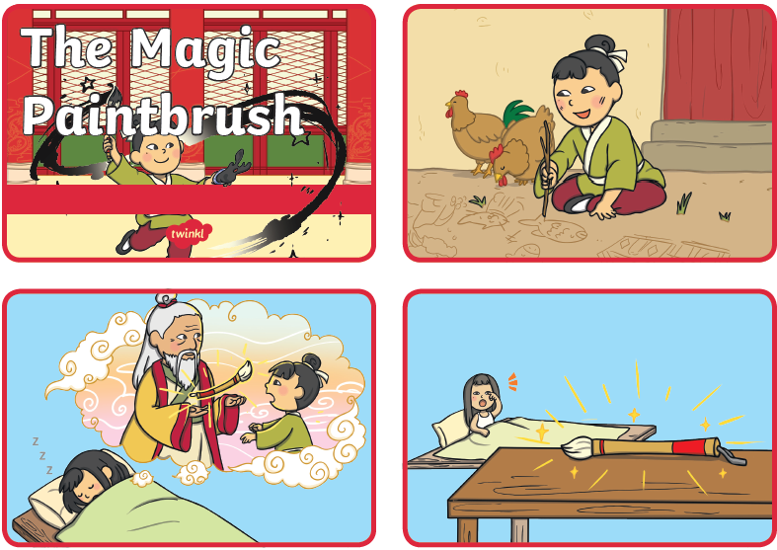
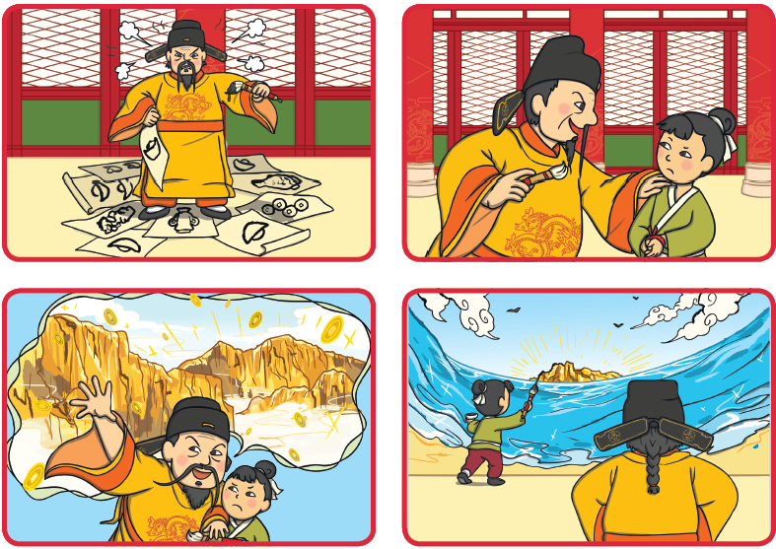
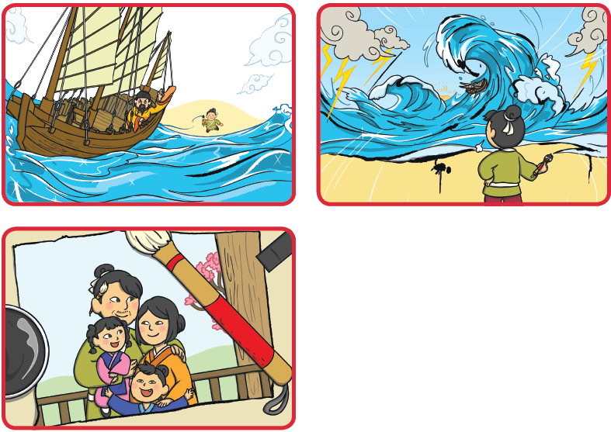
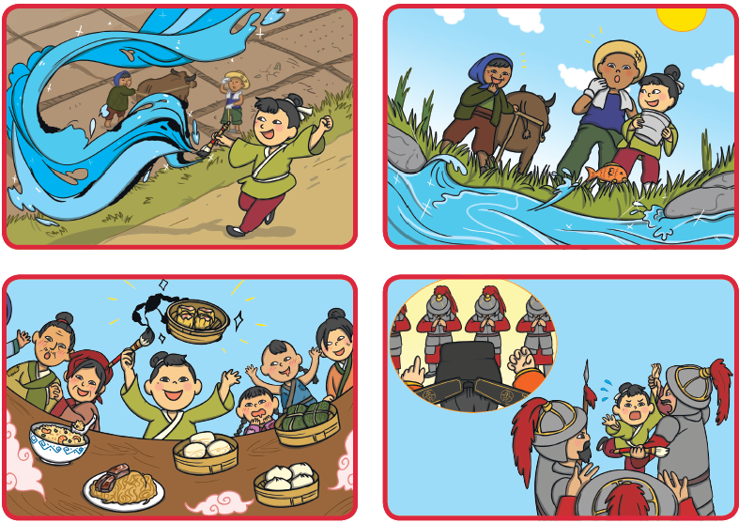
Pictures for printing out are on the class webpage

Slide 2
Thursday objective: To sequence the story
Stories always have a beginning, a middle and an end.
The beginning introduces the characters, the setting and the start of the storyline.
The middle usually has a problem which has to be solved, this is often the most exciting part of the story.
The ending, closes the story for the reader and explains what happens to the characters after the problem has been solved.

Slide 3
Thursday Task: To design a story map for The Magic Brush
Year 1
Your task is to cut out the pictures
Put them in the correct order of the story, write the numbers on the back.
Stick the first picture on a piece of paper or in your book and write a sentence underneath, telling the reader what is happening in the picture.
Continue doing this with all the pictures.
If you find it is taking you too long then you could retell the story and ask an adult to write it for you but you must try 5 sentences yourself.

Slide 4
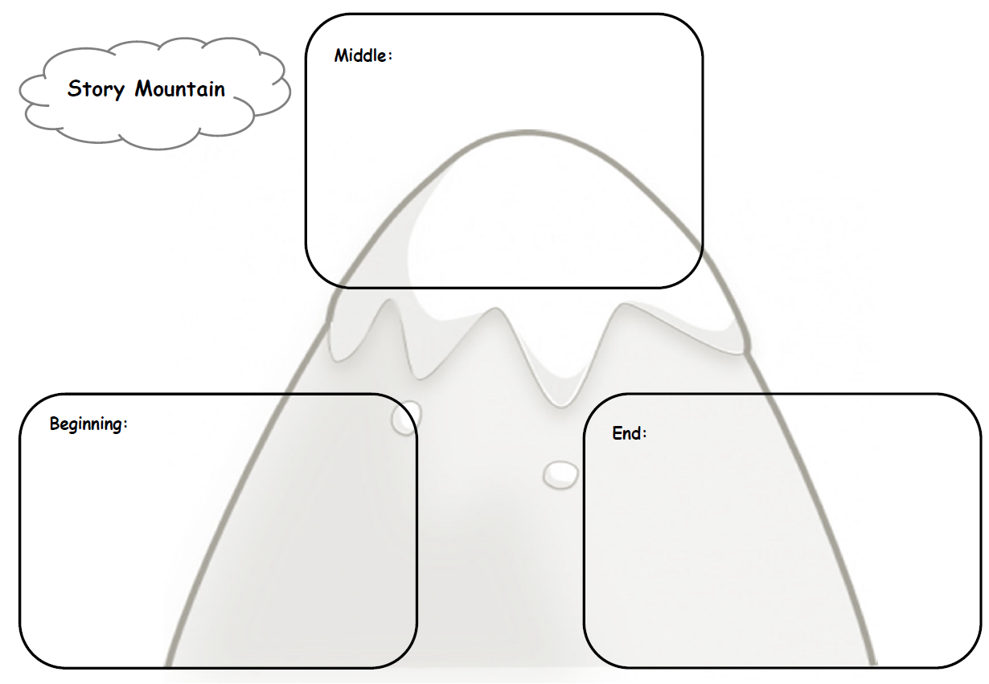
Year 2: Task 1 -This is a story mountain, we have used them before in the last lockdown. Can you add some information onto the story mountain showing the structure of the story i.e beginning – opening, middle – problem/dilemma then the solution, ending. You can use bullet points for this part of the task
Task 2 – Rewrite the story in your own words following your story mountain.

